Slide 1
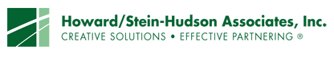

VISIONING
Medfield State Hospital
Public Workshop
Saturday, January 11th, 2014
AGENDA
10:00am Welcome and Introductions
10:15am MSH Property Current Conditions and Considerations
11:00am Issues & Opportunities (I&O) Break-Out Group Session
11:45am I&O Groups Report to All Workshop Participants
12:00pm General Questions and Answers
12:15pm Lunch & Learn
1:15pm Scenario-Building Break-Out Group Session on Future Uses on MSH Property
2:30pm Scenario-Building Group Reports to All Workshop Participants
3:00pm Workshop Wrap Up, Next Steps, and Adjournment

Slide 2
VISIONING
Medfield State Hospital
Public Workshop
Saturday, January 11th, 2014
CURRENT CONDITIONS AND CONSIDERATIONS
Hospital Property Parcels & Proposed Disposition
Hospital Closing and Prior Reuse Plans
Historic Significance of the Property
Environmental Clean-Up
Public Utilities and Infrastructure
Preliminary Agreement Between Town and DCAMM
Financial Context of Agreement

Slide 3
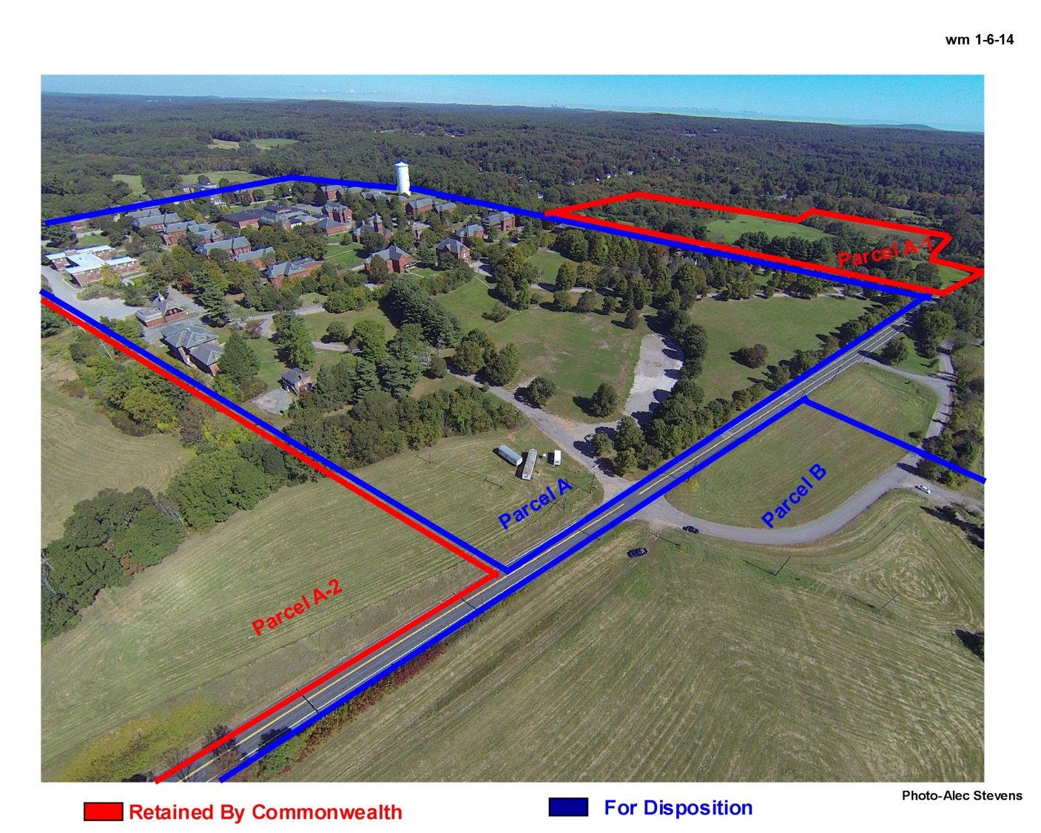
VISIONING
Medfield State Hospital
Public Workshop
Saturday, January 11th, 2014
MSH PARCELS

Slide 4
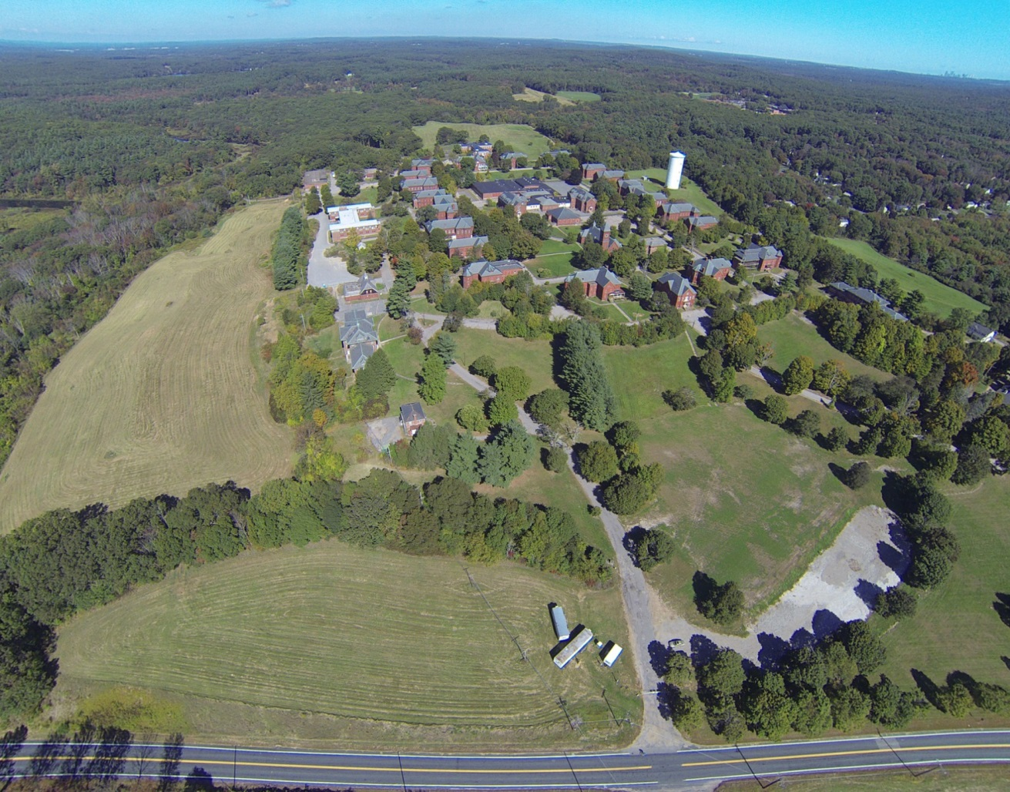
VISIONING
Medfield State Hospital
Public Workshop
Saturday, January 11th, 2014
MSH CORE CAMPUS

Slide 5
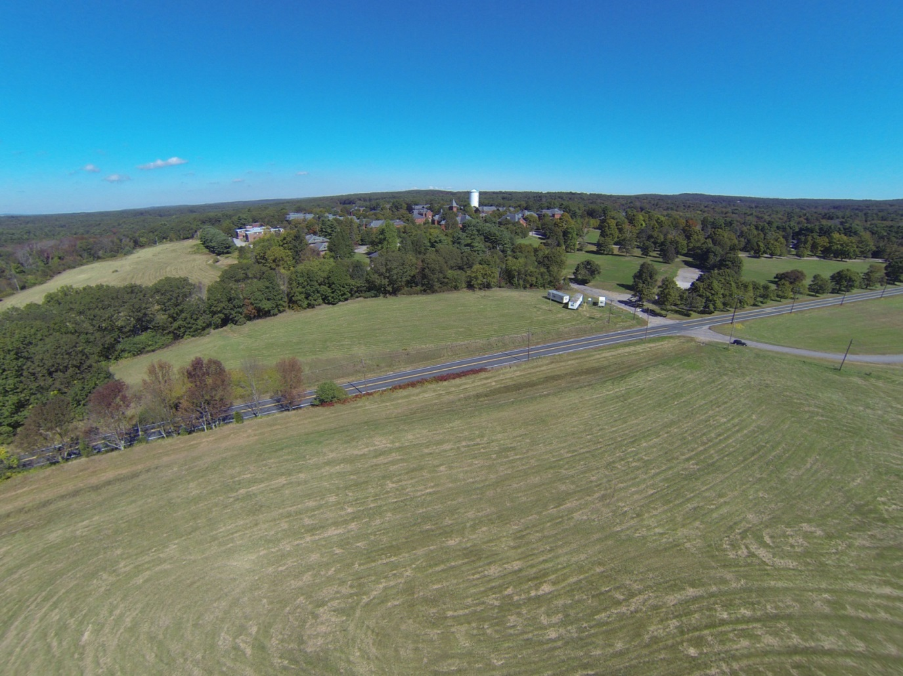
VISIONING
Medfield State Hospital
Public Workshop
Saturday, January 11th, 2014
THE “SLEDDING HILL

Slide 6
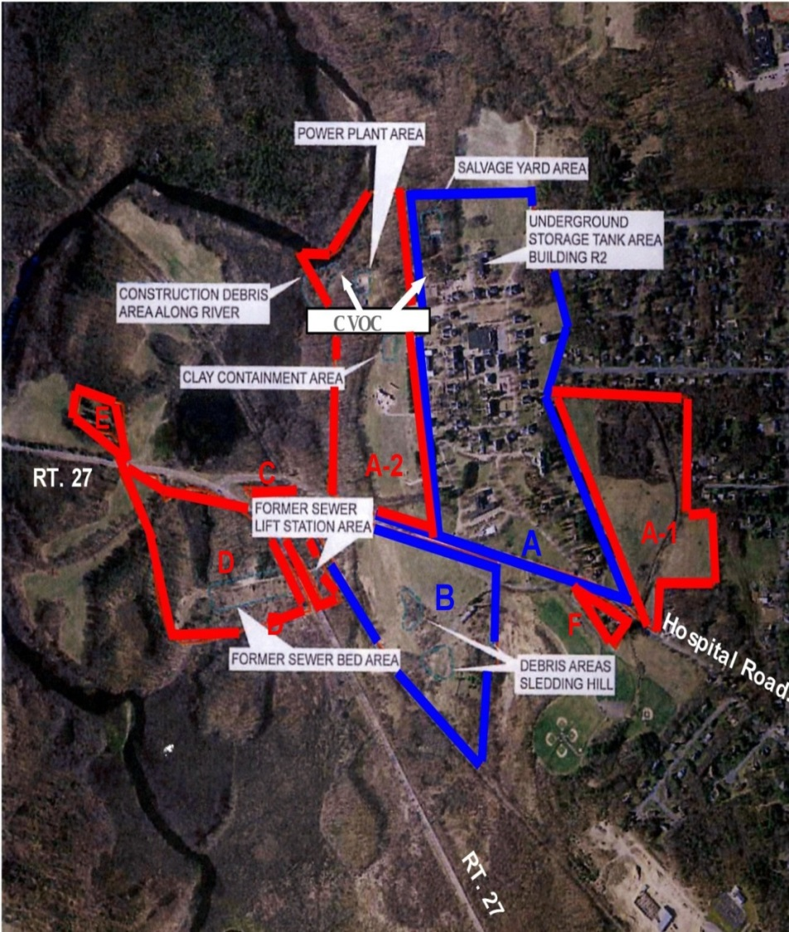
VISIONING
Medfield State Hospital
MSH Base Map - Parcels
SALE PARCELS (~94 acres)
Parcel A – Core Campus (~94 acres)
Salvage Yard: Removal Completed
CVOCs (chlorinated volatile organic compounds): Remediation in Process
Underground Tanks: Removed
Likely New Water Tower Location
Parcel B – Field & Sledding Hill (~40 acres)
Debris Areas: Debris Removed & Soil Tested
STATE-RETAINED PARCELS (~115 acres)
Parcel A1 – Fields to be transferred to Dept of Conservation and Recreation / Dept of Agricultural Resources (~36 acres)
Parcel A2 – Fields & Riverside to be transferred to Dept. of Conservation and Recreation / Dept. of Agricultural Resources (~38 acres)
Clay Containment Area: Removal Completed
C&D Area (Construction Debris): Mediated Cleanup & Restoration begins June 2014 / Complete October 2015
Power Plant: Cleanup proposal due March 2014
CVOC’s: Remediation in Process
Parcel C – Former Lift Station Area (~ 6 acres) (Conservation)
Deactivated & Connections Closed
Parcel D – Firing Range to be transferred to Dept. of Public Safety
(~ 30 acres)
Former Sewer Beds: Tested. No issues reported
Parcel E – Cemetery to be transferred to Dept. of Mental Health
(~ 3 acres)
Parcel F – Active transitional home and will remain as such (~ 3) acres)

Slide 7
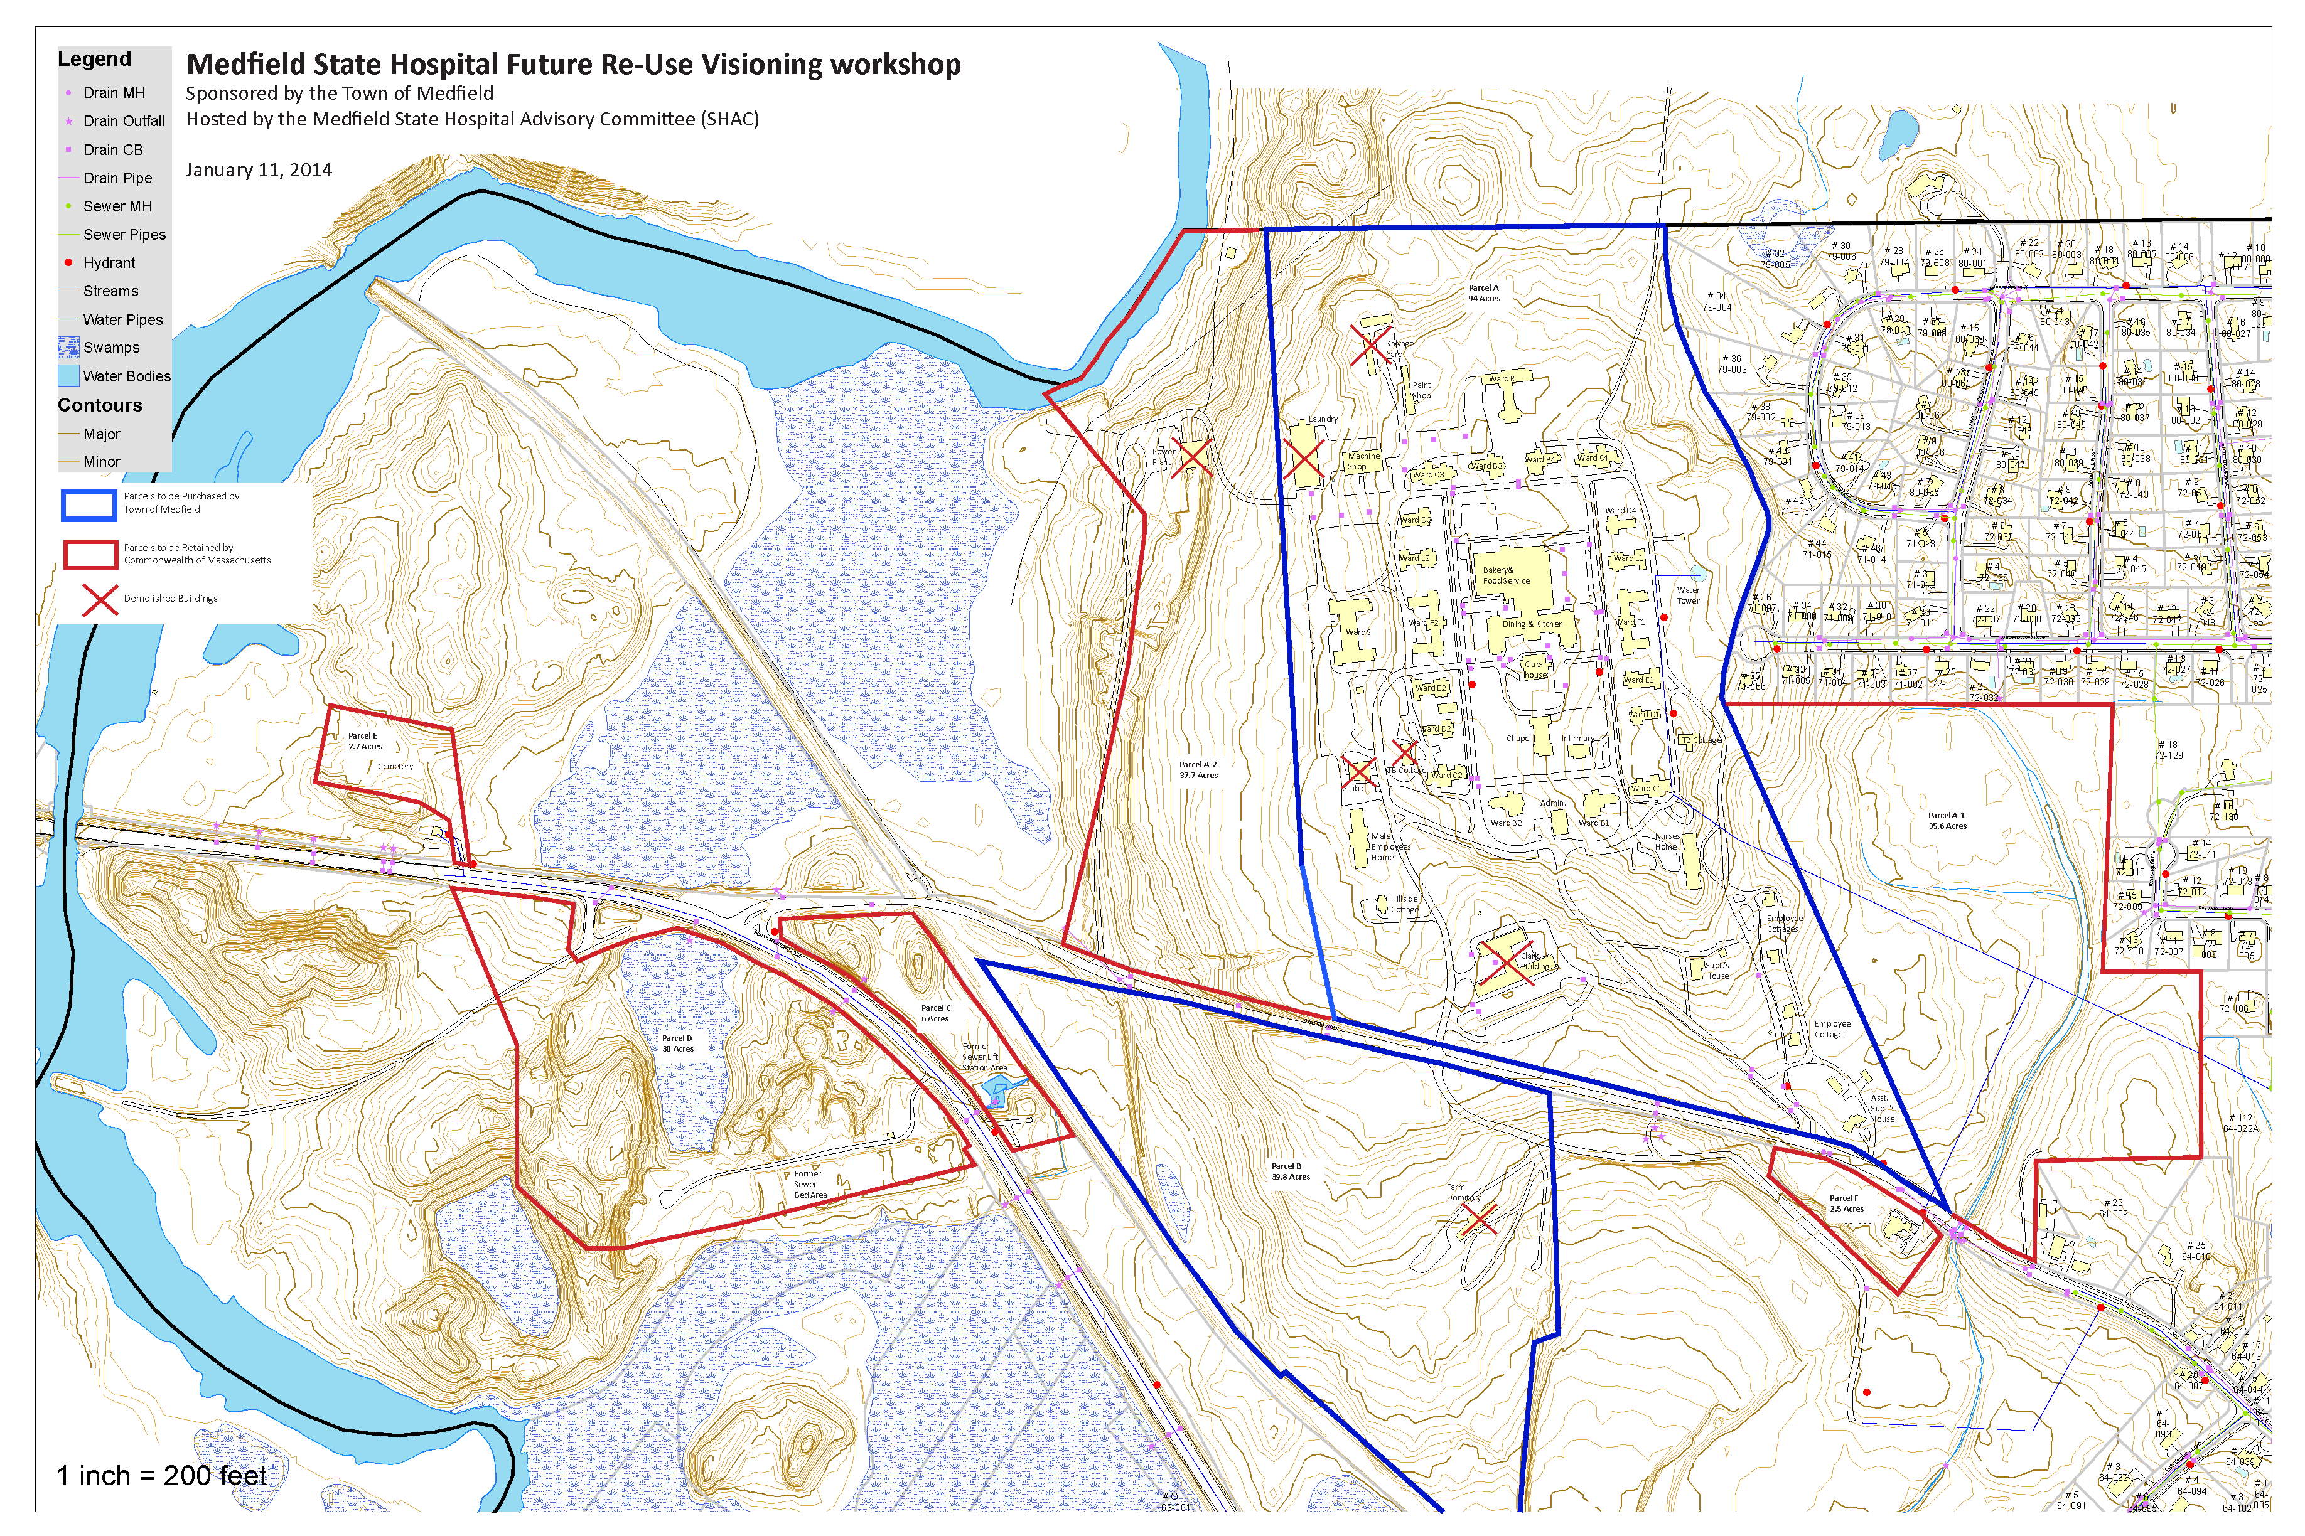
VISIONING
Medfield State Hospital
Base Map – Site Plan

Slide 8
VISIONING
Medfield State Hospital
Public Workshop
Saturday, January 11th, 2014
CURRENT CONDITIONS AND CONSIDERATIONS
Hospital Property Parcels & Proposed Disposition
Hospital Closing and Prior Reuse Plans
Historic Significance of the Property
Environmental Clean-Up
Public Utilities and Infrastructure
Preliminary Agreement Between Town and DCAMM
Financial Context of Agreement
Bill Massaro

Slide 9
VISIONING
Medfield State Hospital
HISTORY OF HOSPITAL‘S CLOSING & PRIOR REUSE INVESTIGATIONS
2003 Hospital closed and Department of Mental Health (DMH) transferred its 250 acres to Division of Capital Asset Management & Maintenance ( DCAMM).
State advised that they would offer core campus for Developer purchase with main goal of housing , historic preservation, and some provision for DMH clients allowing the Town to participate in reuse planning.
Town given opportunity under a “friendly 40B” to remove threat of Comprehensive Permitting of 1,000+ units
Reuse Committee formed with Medfield residents & representatives from Sherborn, Dover and Millis. Initial focus was on a Continuing Care Retirement Community before yielding to State’s advice that Developer profit requirements could only be met by housing.
2005 Town agreed to State's plan for 440 units consisting of 23 single family homes, 9 renovated cottages, and 408 apartments and condo’s in 16 new and 32 renovated MSH buildings . With 79 planned affordable units in renovated buildings, the Town would be credited with 259 units thereby exceeding the 10% Town-wide 40B mandate.
2008 Chapter 269 legislation authorized the 440 unit development with added stipulation that 44 units be included for clients of DMH.
Legislation also restricted other uses of property - could not be sold for use as incinerator, landfill, house of correction, jail, or prison

Slide 10
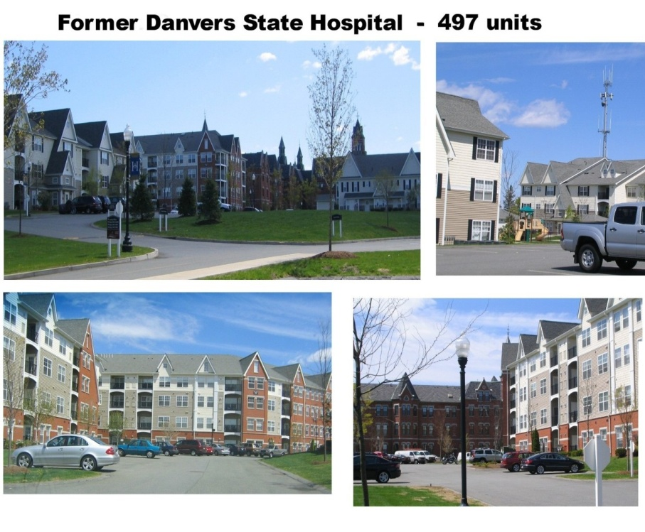
VISIONING
Medfield State Hospital
PRIOR REUSE PLAN
In June 2009 DCAMM presented their artist’s conception of how the 440-unit development might look . They referenced recent Danvers and Lexington former hospital redevelopments as example of how new construction would be blended with renovated existing buildings.

Slide 11
VISIONING
Medfield State Hospital
Public Workshop
Saturday, January 11th, 2014
CURRENT CONDITIONS AND CONSIDERATIONS
Hospital Property Parcels & Proposed Disposition
Hospital Closing and Prior Reuse Plans
Historic Significance of the Property
Environmental Clean-Up
Public Utilities and Infrastructure
Preliminary Agreement Between Town and DCAMM
Financial Context of Agreement
Michael Taylor

Slide 12
VISIONING
Medfield State Hospital
Public Workshop
Saturday, January 11th, 2014
HISTORIC SIGNIFICANCE OF THE PROPERTY
Medfield State Hospital (MSH) began operation in 1896.
Originally 25 buildings and a large barn on 425 acres.
Built as a psychiatric hospital to relieve crowding at other state facilities.
1920’s - 1950’s, the facility had grown to patient population over 2,000 people.
Since 1960’s, changes in the care of the mentally ill led to a decline in the population.
MSH closed completely in 2003.
Michael Taylor

Slide 13
VISIONING
Medfield State Hospital
Public Workshop
Saturday, January 11th, 2014
CURRENT CONDITIONS AND CONSIDERATIONS
Hospital Property Parcels & Proposed Disposition
Hospital Closing and Prior Reuse Plans
Historic Significance of the Property
Environmental Clean-Up
Public Utilities and Infrastructure
Preliminary Agreement Between Town and DCAMM
Financial Context
John Thompson

Slide 14

Hospital Environmental Assessment Areas & DCAMM Cleanup Status wm 12-29-13
Sale Parcels-134 Acres
A Core Campus 94 Acres
-Salvage Yard : Removal Completed
-CVOC’s : Remediation in Process
-U/G Tanks : Removed
B Field & Sledding Hill 40 Acres
-Debris Areas : Debris Removed & Soil Tested
State-Retained Parcels- 115 Acres
A-1 Fields - 36 Acres (Depts of Conserv & Agricult)
No issues Reported
A-2 Fields & Riverside- 38 Acres (Conserv&Agricult)
-Clay Containment Area: Removal Completed
-C&D Area: Mediated Cleanup & Restoration
Begin Jun 2014/Complete Oct 2015
-Power Plant: Cleanup proposal due Mar 2014
-CVOC’s : Remediation in Process
C Former Lift Station Area- 6 Acres (Conservation)
Deactivated & Connections Closed
D Firing Range - 30 Acres (Public Safety)
-Former Sewer Beds: Tested. No issues reported
E Cemetery- 3 acres
F Transitional Program-3 Acres

Slide 15
VISIONING
Medfield State Hospital
Public Workshop
Saturday, January 11th, 2014
CURRENT CONDITIONS AND CONSIDERATIONS
Hospital Property Parcels & Proposed Disposition
Hospital Closing and Prior Reuse Plans
Historic Significance of the Property
Environmental Clean-Up
Public Utilities and Infrastructure
Preliminary Agreement Between Town and DCAMM
Financial Context of Agreement
Jeremy Marsette

Slide 16
VISIONING
Medfield State Hospital
Public Workshop
Saturday, January 11th, 2014
PUBLIC UTILITIES AND INFRASTRUCTURE
Capacity exists at the wastewater treatment plant for future reuse.
Water withdrawal permits restrict the Town to 1.5 millions of gallons of water per day regardless of any future development throughout the town.
A new utilities (sewer, water, drainage, etc.) infrastructure would be necessary to accompany any future developments.
State’s environmental clean-up mediation include transfer the land that surrounds Water Tower (Parcel A) to Town.
Town may replace Water Tower and provide needed public water storage capacity.
Ted Brovitz

Slide 17
VISIONING
Medfield State Hospital
Public Workshop
Saturday, January 11th, 2014
CURRENT CONDITIONS AND CONSIDERATIONS
Hospital Property Parcels & Proposed Disposition
Hospital Closing and Prior Reuse Plans
Historic Significance of the Property
Environmental Clean-Up
Public Water Supply/Water Tower and Wellfields
Preliminary Agreement Between Town and DCAMM
Financial Context of Agreement
Ken Richards

Slide 18
VISIONING
Medfield State Hospital
Public Workshop
Saturday, January 11th, 2014
PRELIMINARY AGREEMENT BETWEEN TOWN AND DCAMM
Town can purchase Parcels A and B totaling 134 acres for $3.1 million spread interest-free over 10 years at $310,000 per year.
Per acre price is $23,134
As Town resells sections of the property, the State will share up to 50% of the net proceeds.
Resales within 5 years can increase Town’s share up to 70% of net proceeds.
No restrictions on Town’s Reuse or Resale of 94-Acre Core Campus (Parcel A) .
Construction on 12 acres of Parcel B (Sledding Hill and former farm fields) is limited to one Town building.
Remaining 28 acres on Parcel B are under Conservation/ Agricultural restrictions.
Ken Richards

Slide 19
VISIONING
Medfield State Hospital
Public Workshop
Saturday, January 11th, 2014
CURRENT CONDITIONS AND CONSIDERATIONS
Hospital Property Parcels & Proposed Disposition
Hospital Closing and Prior Reuse Plans
Historic Significance of the Property
Environmental Clean-Up
Public Water Supply/Water Tower and Wellfields
Preliminary Agreement Between Town and DCAMM
Financial Context of Agreement
Gus Murby

Slide 20

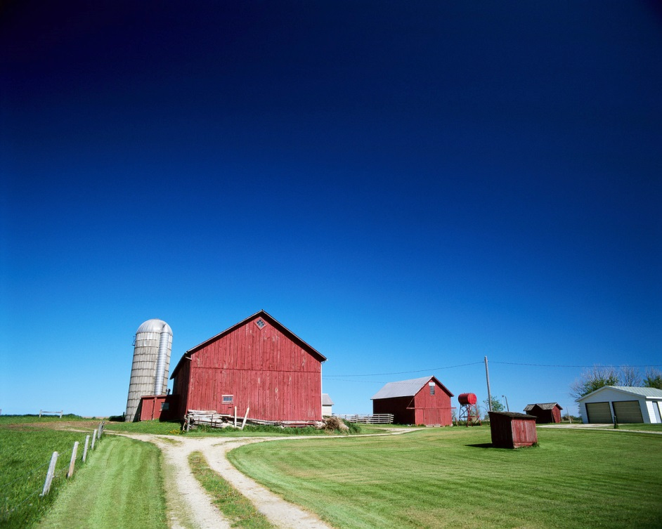
This is a “Bigger Than a Breadbox, Smaller Than a Barn” Discussion

Slide 21
What’s the Cost of This Property?
ANNUAL OPERATING COSTS
$1/3M PER YEAR (HOW LONG DO WE WANT TO TAKE?)
REMEDIATION/ DEMOLITION OF BUILDINGS
$10M – 20M
PURCHASE PRICE
$3.1 M

Slide 22
What’s the Value of This Property?
CATEGORY | WHAT’S IT WORTH?
PARCEL A (in “ready to develop” condition) | Assume $10 – 20M?
DIRECT VALUE FOR TOWN USE (e.g., land value for town building allowed on Parcel B, possible use of Parcel A buildings)
“QUALITY OF LIFE” VALUE (open space, conservation, recreation, historic preservation)
VALUE OF CONTROLLING HOW THIS PROPERTY IS DEVELOPED (Avoided costs associated with possible state-chosen redevelopment)
Our overall assessment of the value of the property should exceed what we spend on it!

Slide 23
How Much Cash Will We Spend on This Property?
$M
$310,000 Interest-free loan repayment
$333,000 Estimated annual operating cost
Remediation/demolition costs are in addition
Town capital investment costs are in addition
$2.6M
$1.9M
$1.3M
$ .6M
1st Year
2nd Year
3rd Year
4th Year

Slide 24
What Can We Afford?
PURPOSE OF DEBT * | INCREASE | DECREASE | NET
Town Debt (at start of FY14) |  |  | $32.4M
Debt Retired (FY14)
FY14 |  | $4.1M | $28.3M
FY15 |  | $4.4M | $24.0M
Debt Added in FY14
DPW Building Construction | $9.5M |  | $33.5M
Red Gate Farm Purchase | $1.4M |  | $34.9M
Potential New Debt
State Hospital Purchase | $3.1M |  | $38.0M
Hospital Water Tower Design/Construction and Mains | $4.5M |  | $42.5M
Design/Construction of Public Safety Bldg | $19M (if financed in FY15) |  | $61.4M
* NOTE: Debt figures here include Water and Sewer Enterprise Fund debt

Slide 25
VISIONING
Medfield State Hospital
Public Workshop
Saturday, January 11th, 2014
ISSUES & OPPORTUNITIES BREAK-OUT SESSION
Groups of 10 to 15 Participants
Each Participant Identify Top Issues, Concerns, and Vision for Future Use (45 Min.)
Groups Report Back to All Workshop Participants (15 Min.)

Slide 26
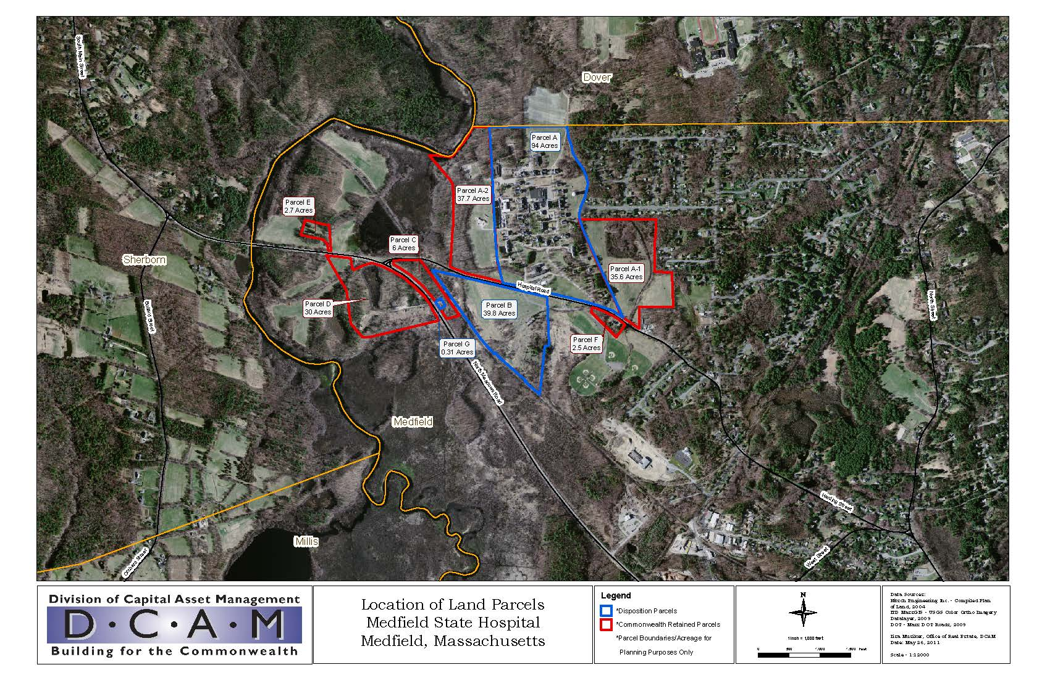
VISIONING
Medfield State Hospital
Public Workshop
Saturday, January 11th, 2014
GENERAL QUESTIONS & ANSWERS

Slide 27
VISIONING
Medfield State Hospital
Public Workshop
Saturday, January 11th, 2014
LUNCH & LEARN
The Partnership Model
Legislative Timeline
Building Conditions
Community Survey Results
Market Potential
Case Studies from Other State Hospitals

Slide 28
VISIONING
Medfield State Hospital
Public Workshop
Saturday, January 11th, 2014
LUNCH & LEARN
The Partnership Model
Legislative Timeline
Building Conditions
Community Survey Results
Market Potential
Case Studies from Other State Hospitals

Slide 29
What Can We Afford?
PURPOSE OF DEBT * | INCREASE | DECREASE | NET
Town Debt (at start of FY14) |  |  | $32.4M
Debt Retired (FY14)
FY14 |  | $4.1M | $28.3M
FY15 |  | $4.4M | $24.0M
Debt Added in FY14
DPW Building Construction | $9.5M |  | $33.5M
Red Gate Farm Purchase | $1.4M |  | $34.9M
Potential New Debt
State Hospital Purchase | $3.1M |  | $38.0M
Hospital Water Tower Design/Construction and Mains | $4.5M |  | $42.5M
Design/Construction of Public Safety Bldg | $19M (if financed in FY15) |  | $61.4M
* NOTE: Debt figures here include Water and Sewer Enterprise Fund debt

Slide 30
VISIONING
Medfield State Hospital
Public Workshop
Saturday, January 11th, 2014
THE PARTNERSHIP MODEL
Allows the Town to control the end use destiny of the Property:
The Town may acquire title to the Property on an unrestricted use* basis by paying the State a portion of its "sunk costs"**
Unrestricted use allows the Town the flexibility to choose to
Retain the Property (or portions of) for a direct public use and/or
Sell the Property {or portions of) to a private developer;
Town can receive 50% of the net resale proceeds and up to an additional 20% if certain redevelopment milestones are met
*Unrestricted Use - Town may retain the Property (or portions of) for a direct public use or sell the Property (or portions of) to a private developer.
**Sunk Cost - Sunk Costs are capital expenditures and operating expenses (hard cost and soft costs) incurred by the Commonwealth to improve, maintain, replace or repair the Proposed Disposition Parcel which includes land, infrastructure and improvements. Costs incurred in preparation for or after closure of the facility.
Steve Browne

Slide 31
VISIONING
Medfield State Hospital
Public Workshop
Saturday, January 11th, 2014
THE PARTNERSHIP MODEL
Redevelopment Milestone Incentives:
Buyer (Town) shall be entitled to a base percentage of 50% of any net resale/ground lease proceeds. As an incentive, the Buyer can earn up to an additional 20% of the net resale/ground lease proceeds according to the following breakdown listed below:
Additional10% if the Buyer resells/ground leases the Property within 1- 2 years of original Closing Date.
Additional 5% if the Buyer resells/ground leases the Property within 3- 5 years of the Closing Date.
Additional 2.5 % if the Buyer completes a comprehensive market study to inform land use decisions including zoning for the site.
Additional 2.5% if the Buyer adopts by right zoning (to be informed by market study) on the site a portion of which must be for residential housing of at least 4 units per acre for single family units and 8 units per acre for multifamily units.
Additional 2.5% if the Buyer adopts "Local Expedited Permitting" which provides for expedited permitting (180 days) on a redevelopment site.
Additional 2.5% if the Buyer adheres to the Commonwealth's sustainable development principles in the planning of future development of the site.
Steve Browne

Slide 32
VISIONING
Medfield State Hospital
Public Workshop
Saturday, January 11th, 2014
LUNCH & LEARN
The Partnership Model
Legislative Timeline
Building Conditions
Community Survey Results
Market Potential
Case Studies from Other State Hospitals
John Harney

Slide 33
VISIONING
Medfield State Hospital
Public Workshop
Saturday, January 11th, 2014
LEGISLATIVE TIMELINE
Anticipated Time-Line for MSH Legislative Process:
Event | Schedule | Comments
Public Visioning Workshop | January 11, 2014 | Documentation of Public Views
Prepare for Warrant Committee and Special Town Meeting | Complete by February 14, 2014 | Economic, financial, and impacts analyses of alternative plans
Warrant Committee Meetings | January/February | Position on Warrant Article prior to Special Town Meeting
Special Medfield Town Meeting to Vote on Acquisition of Property | No later than March 17, 2014 | Date not yet finalized by Town
Draft Purchase &Sales Agreement and Transfer Legislation | Complete drafts by March 28, 2014 | Medfield takes lead then reviewed by DCAMM
Special Town Election to Proceed with Acquisition | By March 28, 2014 | May not be necessary -- depends on financial plan, Board Of Selectmen and legislators requests
DCAMM Review P&S and Legislation | Target Completion by April 21, 2014 | Allow one month; Do not anticipate any problems
Annual Town Meeting | April 28, 2014 | Date not yet scheduled
Approval by Mass House and Senate | Allow 2 months (May – June); Target completion by June 30, 2014 | Need to schedule on legislative agendas, conduct hearings, legal review
Send to Governor for Signature and Enactment into Law | July 1, 2014 | Target date prior to recess in light of election year
Senate and House Summer Recess | July - August, 2014
State and Federal Elections | November 4, 2014 | Governor and many high-level officials will be changing

Slide 34
VISIONING
Medfield State Hospital
Public Workshop
Saturday, January 11th, 2014
LUNCH & LEARN
The Partnership Model
Legislative Timeline
Building Conditions
Community Survey Results
Market Potential
Case Studies from Other State Hospitals
Jim Rohnstock

Slide 35
VISIONING
Medfield State Hospital
Public Workshop
Saturday, January 11th, 2014
BUILDING CONDITIONS
2014 Building Assessment Study in progress.
Follow up to 2003 comprehensive building evaluation.
New assessment to analyze four (4) sample buildings on the Quad
Better understand any further deterioration of the buildings due to the lack of stabilization.
4 buildings are on the National Historic Register
Determine if in stable condition, extent of disrepair, and whether structurally unsound.
Jim Rohnstock

Slide 36
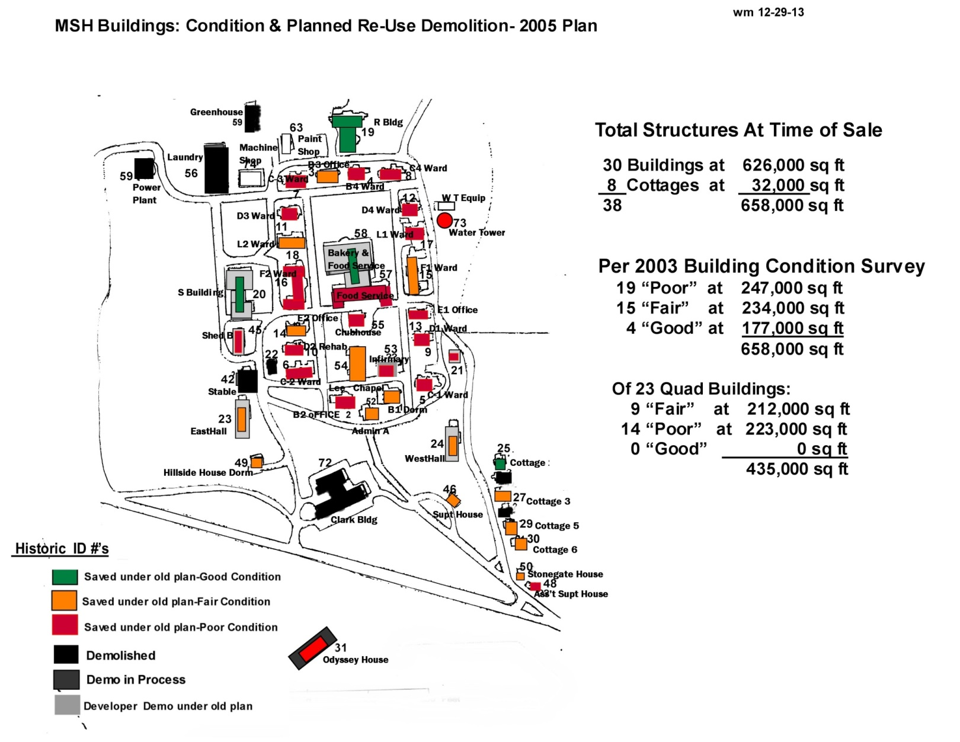
VISIONING
Medfield State Hospital
2005 Building Conditions

Slide 37
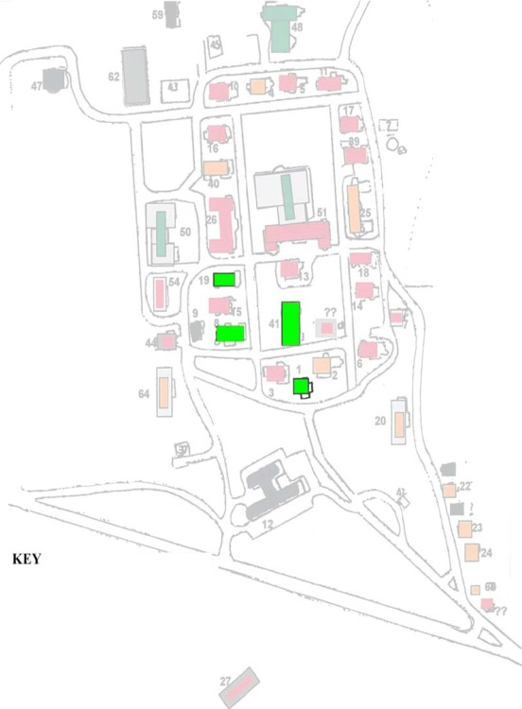
VISIONING
Medfield State Hospital
Buildings to be Evaluated
Chapel (Building 41)
Ward B-1 (Building 1)
Ward C-2 (Building 8)
Ward E-2 (Building 19)

Slide 38
VISIONING
Medfield State Hospital
Public Workshop
Saturday, January 11th, 2014
LUNCH & LEARN
The Partnership Model
Legislative Timeline
Building Conditions
Community Survey Results
Market Potential
Case Studies from Other State Hospitals
Alec Stevens

Slide 39
VISIONING
Medfield State Hospital
Public Workshop
Saturday, January 11th, 2014
COMMUNITY SURVEY RESULTS
93% of respondents are Medfield residents.
89% of respondents are property owners in Medfield.
92% of respondents have been to the MSH site.
79% of respondents aware that DCAMM offering to sell to Town.
56% of respondents aware of potential costs of acquiring site.
95% of respondents concerned about potential for DCAMM to sell property to third party (town losing control of development).
Household Size - Four and two-member households were the most prevalent, together comprising 60% of the responses.
Respondents generally in favor of purchasing the site to retain control of future uses, even if it meant higher taxes.
Alec Stevens

Slide 40
VISIONING
Medfield State Hospital
Public Workshop
Saturday, January 11th, 2014
COMMUNITY SURVEY RESULTS
Recreational Use - Top three choices for future use of the site were recreational (Trails, Open Space, and Rec. Space).
Housing - Top responses for senior housing and no housing at all. Apartments garnered weakest support (about 4% in favor).
Preservation of open space and historic structures were favored, although fewer to support higher taxes for these purposes.
Potential Uses Identified in Market Analysis – Highest support from respondents were recreational facilities, a continuing care facility, and a satellite institutional campus.
Potential Use of State Retained Parcels - The top three choices were passive recreation, active recreation, and open space with no specific use. Community Supported Agriculture, farming, and community gardens also garnered support.
View the full survey results on the website at mshvision.net
Alec Stevens

Slide 41
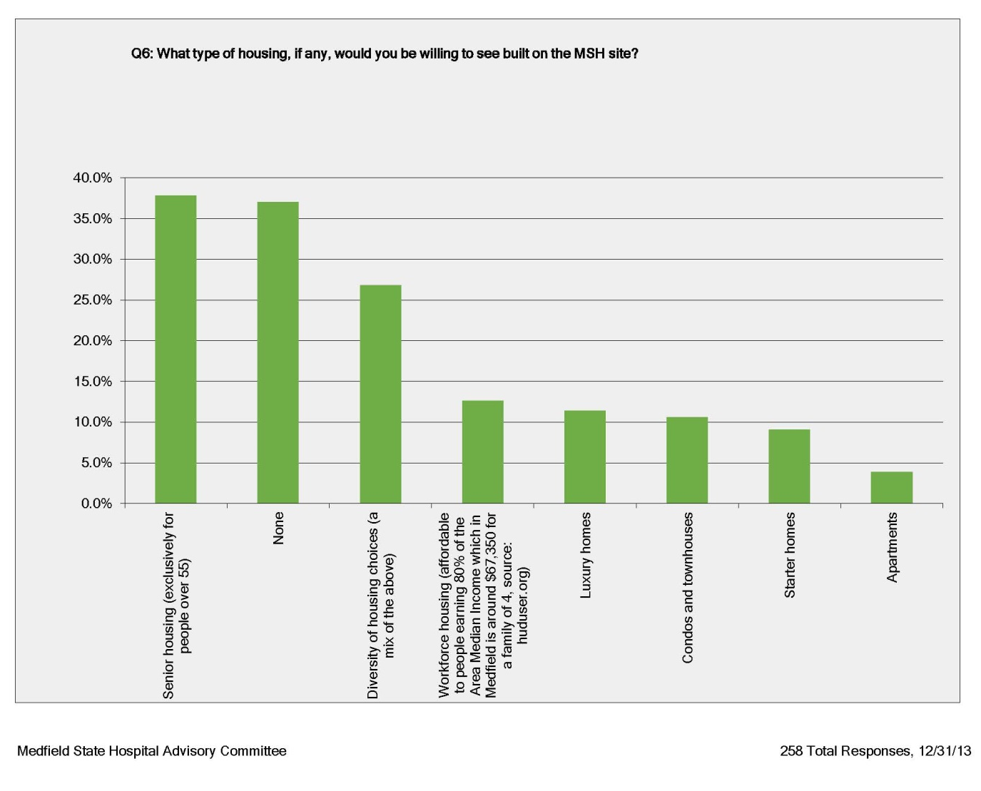
VISIONING
Medfield State Hospital
Public Workshop
Saturday, January 11th, 2014
COMMUNITY SURVEY RESULTS
Alec Stevens

Slide 42
VISIONING
Medfield State Hospital
Public Workshop
Saturday, January 11th, 2014
COMMUNITY SURVEY RESULTS
Alec Stevens

Slide 43
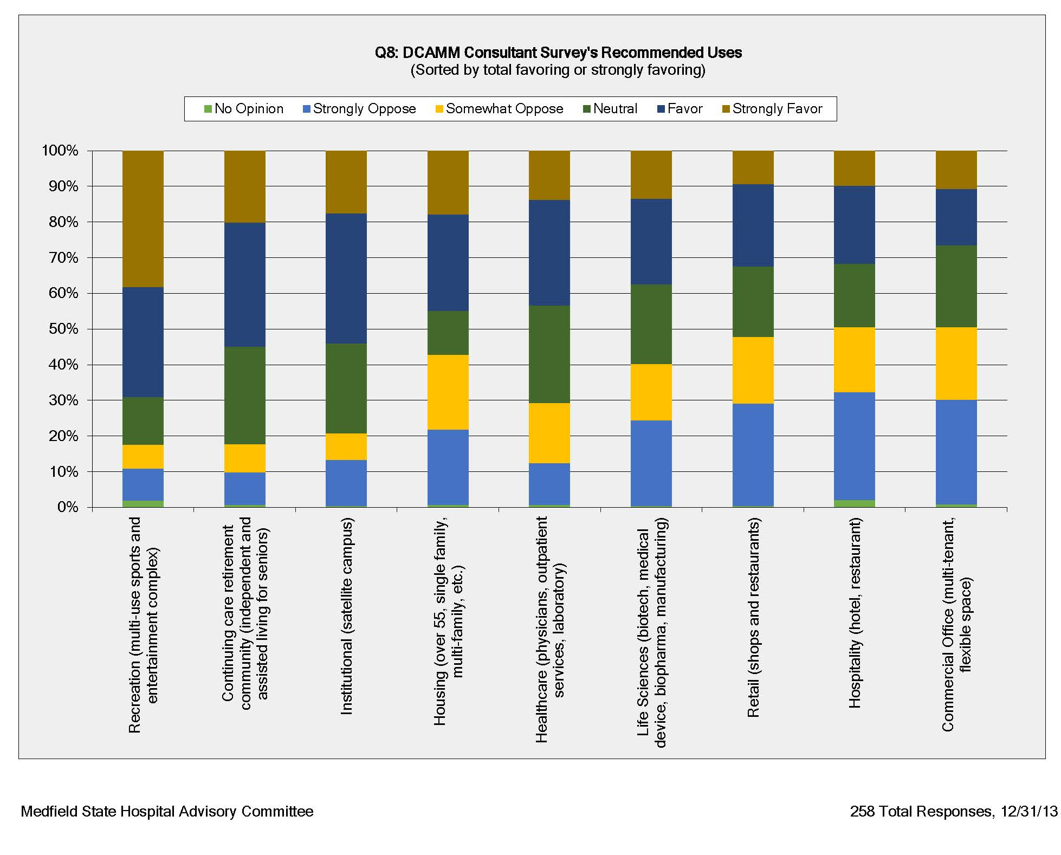
VISIONING
Medfield State Hospital
Public Workshop
Saturday, January 11th, 2014
COMMUNITY SURVEY RESULTS
Alec Stevens

Slide 44
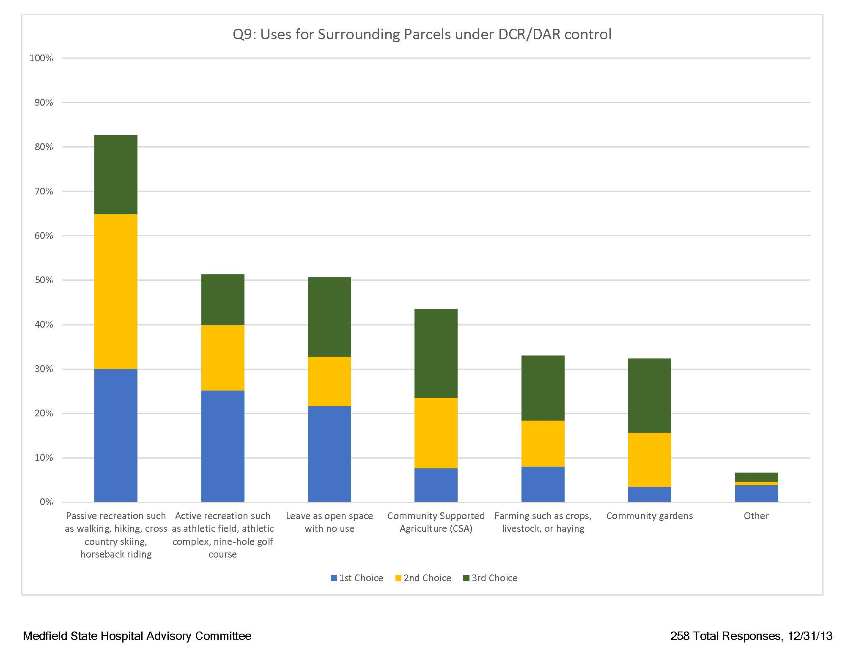
VISIONING
Medfield State Hospital
Public Workshop
Saturday, January 11th, 2014
COMMUNITY SURVEY RESULTS
Alec Stevens

Slide 45
VISIONING
Medfield State Hospital
Public Workshop
Saturday, January 11th, 2014
LUNCH & LEARN
The Partnership Model
Legislative Timeline
Building Conditions
Community Survey Results
Market Potential
Case Studies from Other State Hospitals

Slide 46
VISIONING
Medfield State Hospital
Public Workshop
Saturday, January 11th, 2014
MARKET POTENTIAL
Results of the 2012 Jones, Lange, LaSalle (JLL) Market Study
Lack of access to major highways and relatively weak market limits commercial opportunities
Most Viable Uses
Housing:
Single family, condominium and multifamily rental, with multifamily being the strongest.
Recreation:
Scale of the property and demand for indoor and outdoor recreation space make this desirable use.
Healthcare and/or Continuing Care Retirement:
Aging population and local demographics make this an attractive location.

Slide 47
VISIONING
Medfield State Hospital
Public Workshop
Saturday, January 11th, 2014
MARKET POTENTIAL
Results of the 2012 Jones, Lange, LaSalle (JLL) Market Study
Moderately Viable Uses
Institutional Use (Satellite Campus or Retreat/Conference Center):
Attractive site but demand for institutional use is limited.
Life Sciences:
This sector tends to build ("cluster") around already established major research institutions.
Retail:
Poor location for large scale retail.
Possible demand for small local and specialty businesses.

Slide 48
VISIONING
Medfield State Hospital
Public Workshop
Saturday, January 11th, 2014
MARKET POTENTIAL
Results of the 2012 Jones, Lange, LaSalle (JLL) Market Study
Least Viable Uses
Commercial Office:
Poor opportunity for large office dev. (>50,000 sf).
Possible small scale multiple businesses demand as part of a multi-use retail, recreation, and residential dev.
Hospitality:
Unlikely site for commercial scale, but smaller scale is possibility as part of a mixed use development.
Industrial:
Weakest of the reuse types.
Possible small scale, multi-tenanted buildings catering to businesses operating in Medfield and nearby towns.

Slide 49
VISIONING
Medfield State Hospital
Public Workshop
Saturday, January 11th, 2014
LUNCH & LEARN
The Partnership Model
Legislative Timeline
Building Conditions
Community Survey Results
Market Potential
Case Studies from Other State Hospitals
Gill Rodgers and
Ros Smythe

Slide 50
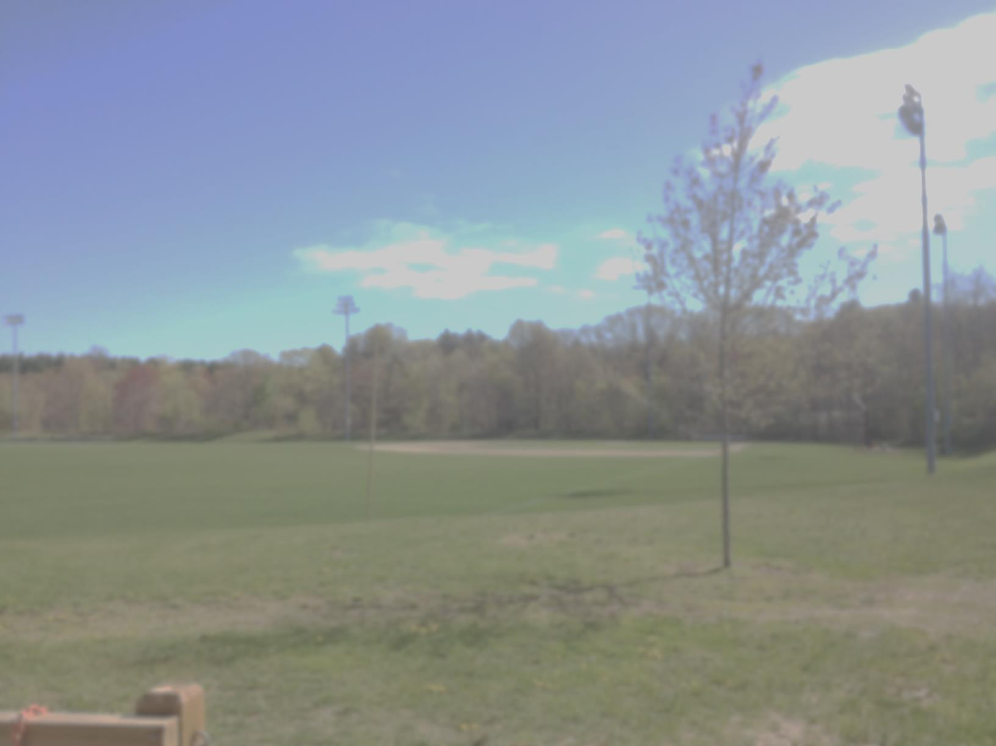
Summary of State Hospital Reuse Projects Prepared for Visioning Workshop
January 11, 2014

Slide 51
Massachusetts State Hospitals
Reuse of the following former state hospitals are summarized in this presentation:
Northampton*
Foxborough*
Boston State*
Tewksbury*
Danvers*
Metropolitan
Westborough
*More details of these hospitals are included on the website: MHSVision.net

Slide 52
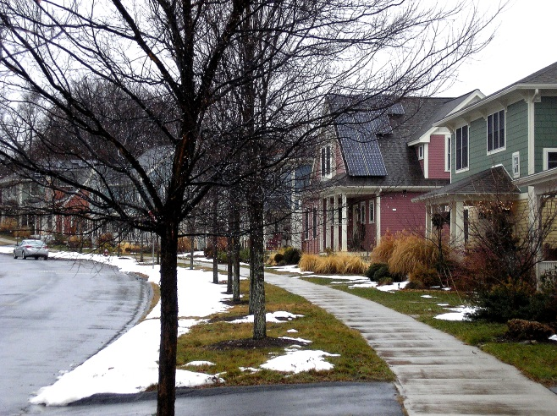
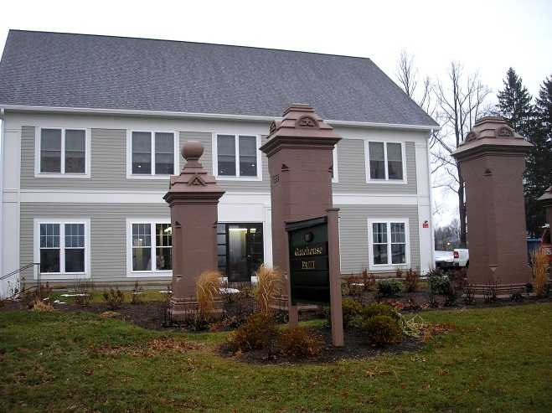
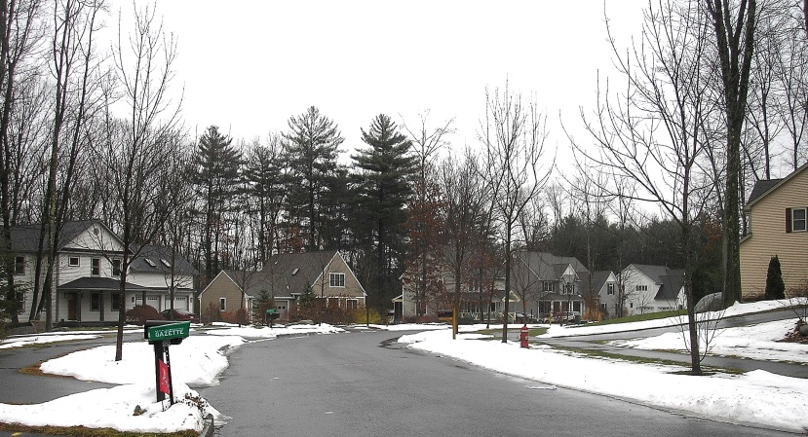
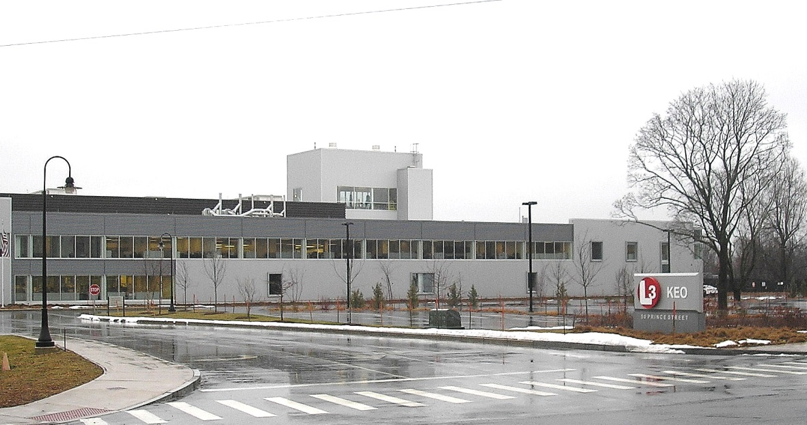
Northampton State Hospital

Slide 53
Northampton State Hospital Reuse
Features:
Village style – compact scale, small lots, mixed uses, and walkable design
190 residential units: apartments, condos, townhouses, single family homes, & assisted living
50% affordable housing
Recreation, light-industrial, retail & state government
Community gardens and athletic fields
Light industrial firms employ over 320 people
Hampshire County jail located on premises
Four original buildings saved and renovated
“Coach House” recently purchased and being renovated for emergency veterinarian clinic
Preserved 75% of land as open-space & agriculture
Key Points:
Detailed and realistic Master Plan
Project owned and managed by MassDevelopment
Pro-active Community Action Committee
Utilized federal and state grants and incentives

Slide 54
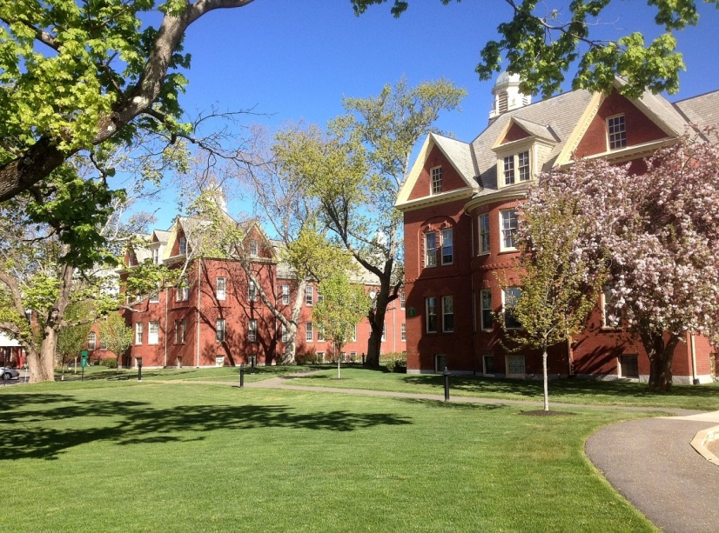
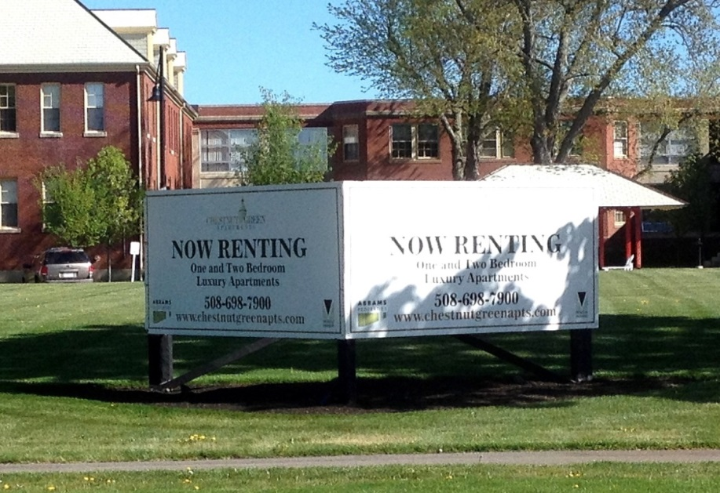
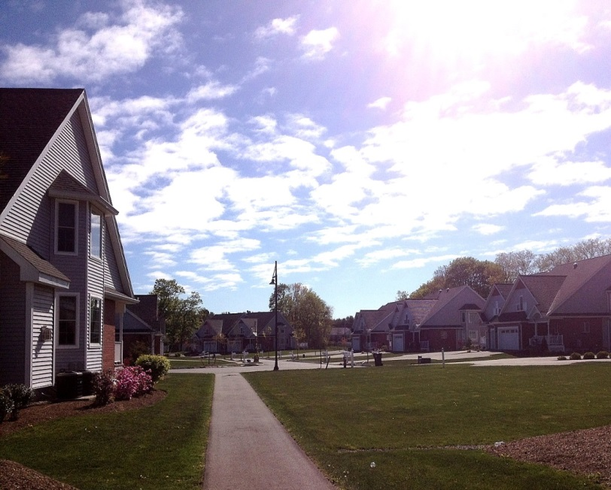
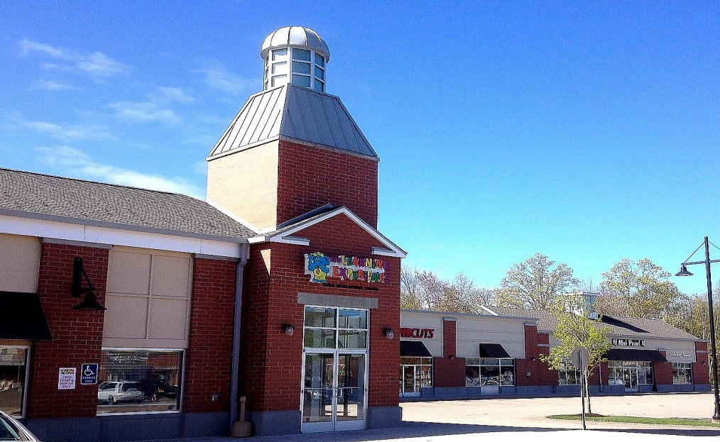
Foxborough State Hospital

Slide 55
Foxborough State Hospital Reuse
Features:
Saved and renovated 4 – 5 of the original buildings
203 mixed residential units: apartments, condos, 2-story townhouses, mid-level single family, high-end single family
Playing fields, recreation areas, retail & commercial office space
Extensive walkways
97% apartment occupancy;
Town houses and condos completely sold out
New public safety building for police and fire
Large retail plaza located on site
Access to Routes 1, 95, 140 and 495 and close to Gillette Stadium
30% of area preserved for open space and recreational purposes
Key Points:
Pedestrian friendly neighborhood plan developed by re-use committee and public with DCAMM
Special zoning district created
Multiple developers – some very successful, others went bankrupt
Extensive use of preservation tax credits and various state funding sources

Slide 56
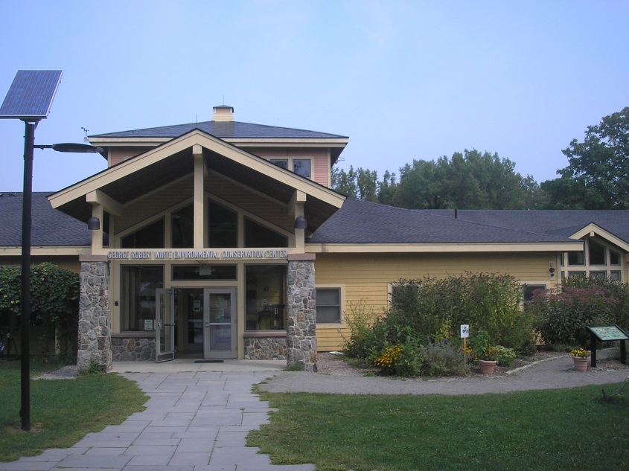
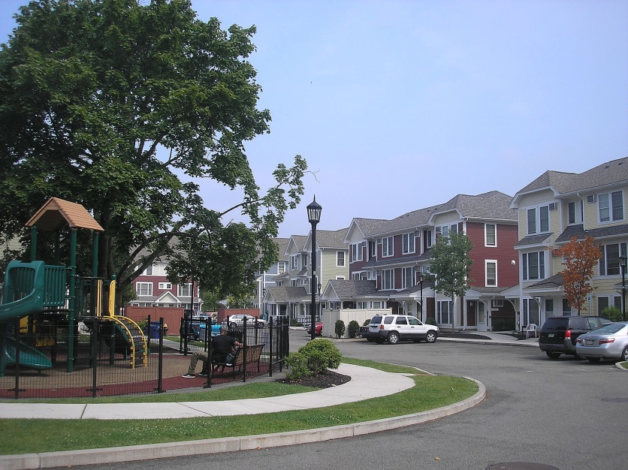
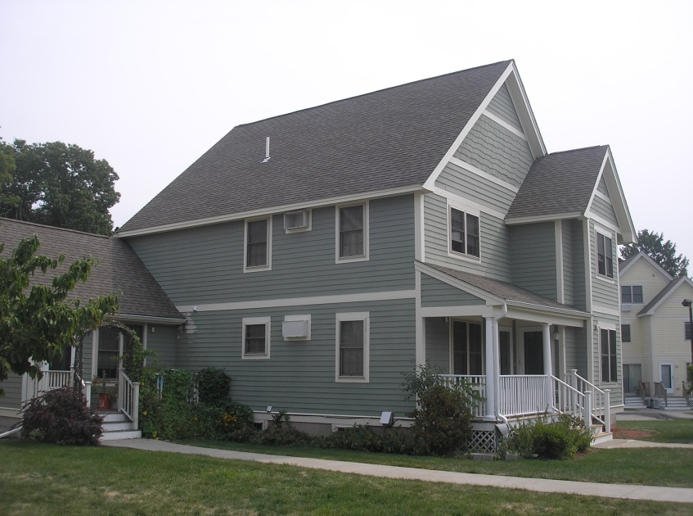
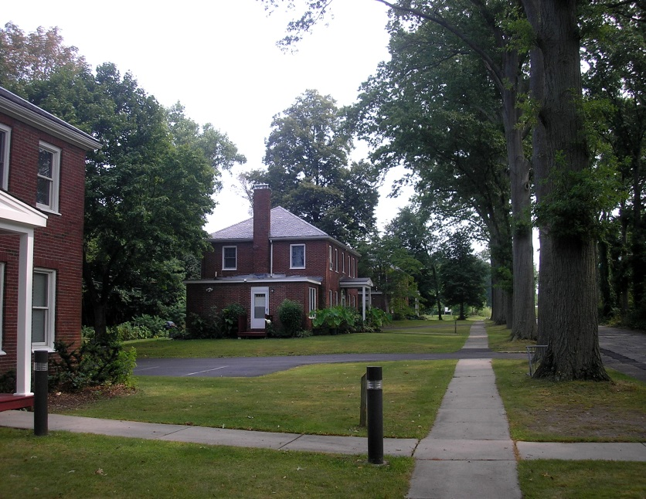
Boston State Hospital (Dorchester/Mattapan)

Slide 57
Boston State Hospital Reuse (Dorchester/Mattapan)
Features:
Lena Park Community: 100 affordable apartments + 65 affordable rental units for seniors
Harvard Commons: 90 single-family houses and duplexes targeted as affordable
Most buildings demolished except for 3 cottages and one building being renovated by Univ. Mass Biologic Laboratory
Mass Audubon Society built Boston Nature Center on 67 acres
Includes 267 community gardens, municipal leaf composting, walking trails
Univ. of Mass. Biologic Laboratories employs 330 people manufacturing vaccines
40% of the total area is undeveloped open-space surrounded by hundreds of acres of wooded property
Key Points:
Very active Citizens Advisory Committee developed Master Plan
Broad range of multi-uses: housing, agriculture, education, and bio-tech
Responsive in meeting local housing and community needs
Extensive use of city, state and federal funding sources

Slide 58
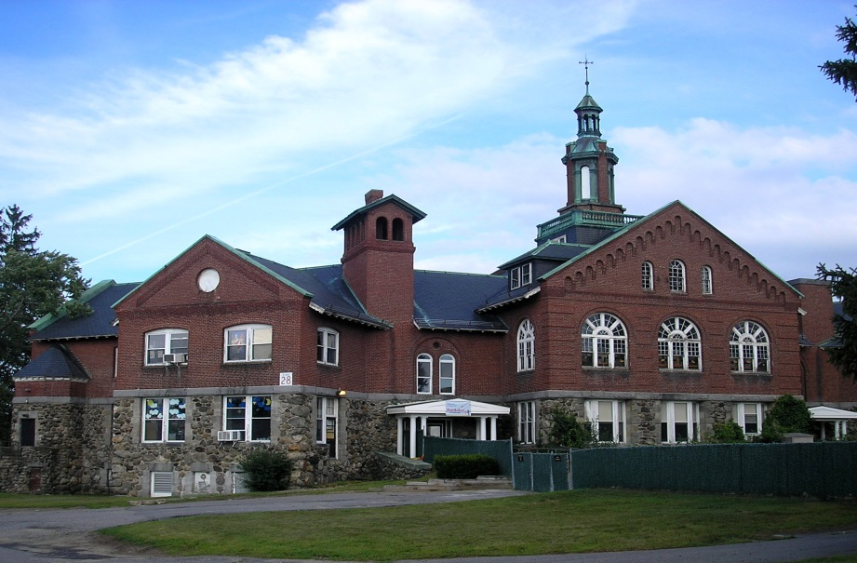
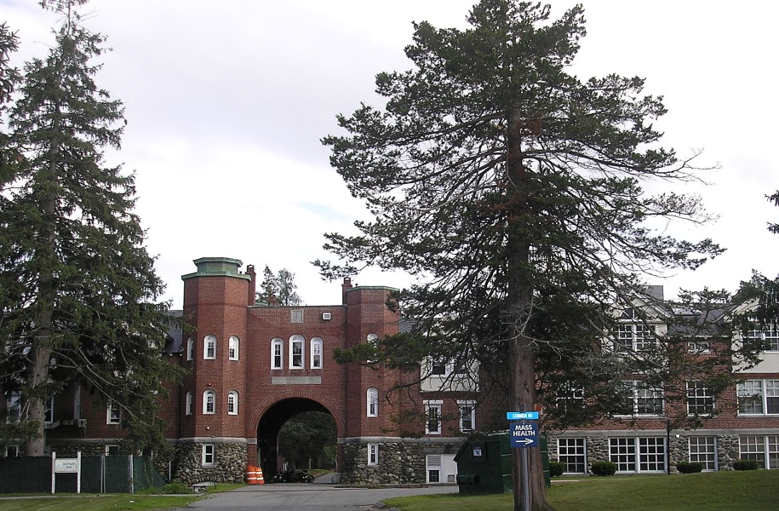
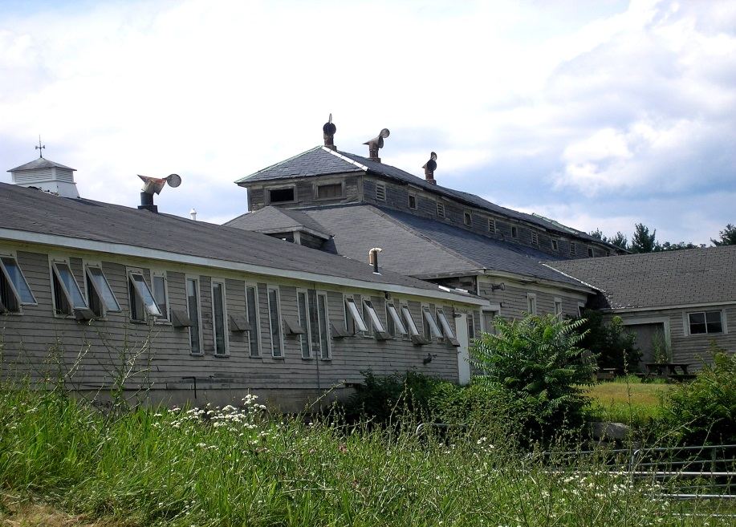
Tewksbury State Hospital

Slide 59
Tewksbury State Hospital
Features:
Hospital is still in full operation after 160 years
Campus-style setting surrounded by 450 acres of conservation and farm land
Equestrian therapy program associated with hospital and available for public use
99-year lease of land and buildings from DCAMM
Restored barn; built stables, riding ring, paddocks, and riding trails
Restored building used for Mass Government offices
60% of total land preserved as conservation for passive recreation including horseback riding
Key Points:
Maintenance of historic hospital buildings for treatment of variety of chronic medical, psychiatric, and additive disorders
Local citizen’s group led development of equestrian program
Equestrian program supported by ongoing subsidies and contributions

Slide 60
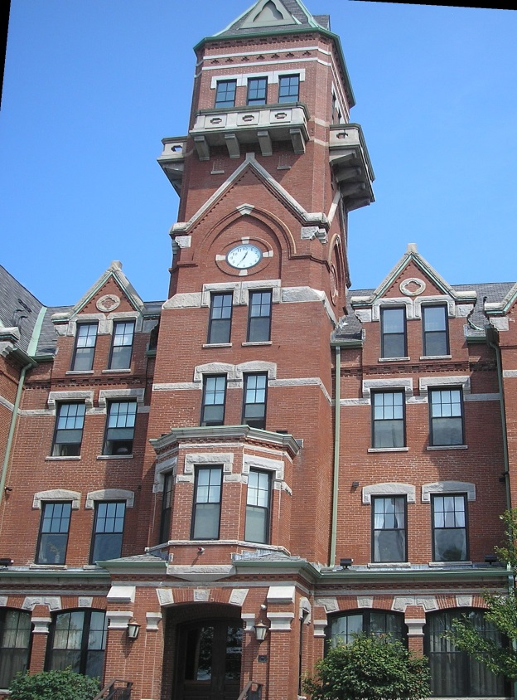
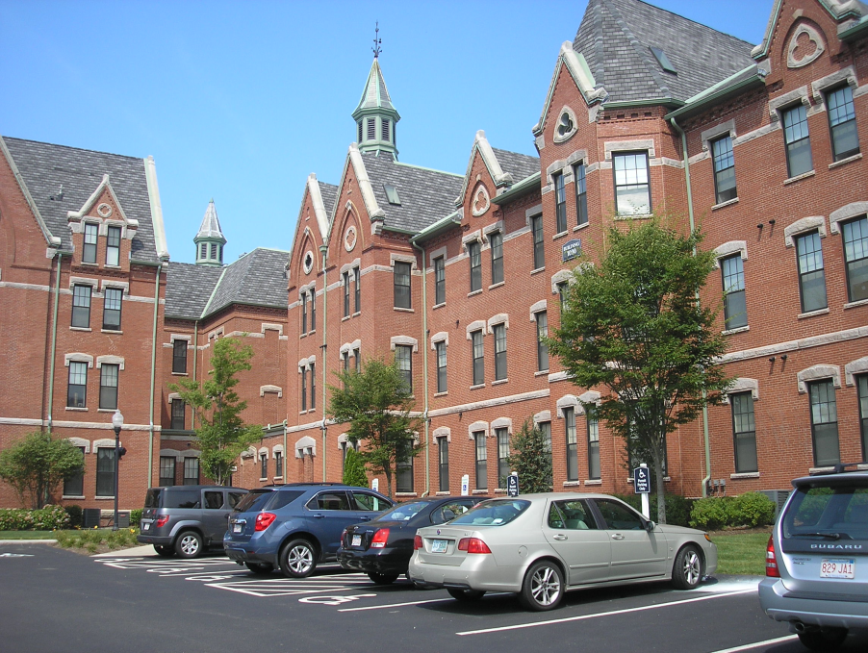
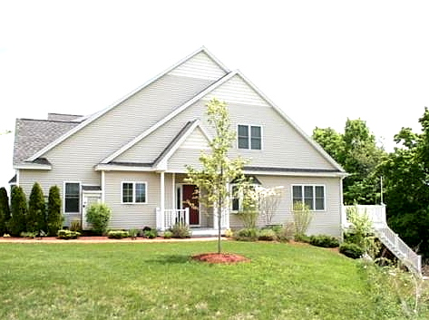
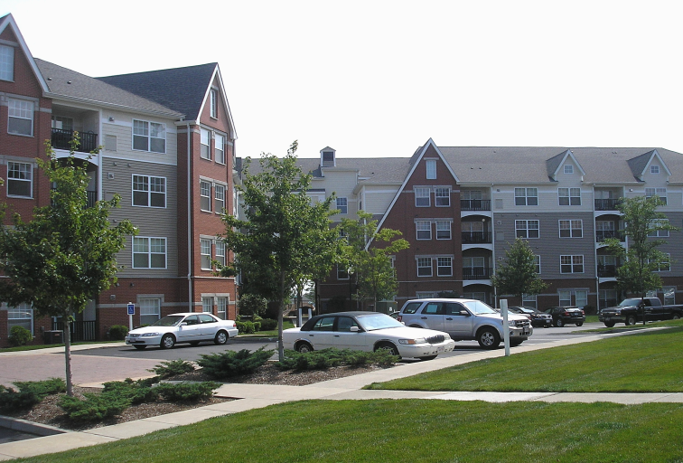
Danvers State Hospital

Slide 61
Danvers State Hospital Reuse
Features:
AvalonBay high-density apartment development
497 primarily 1-BR and 2-BR apartments (some 3-BR)
Renovated iconic Kirkbride Building and two adjoining wings
New construction mimicking architectural style
Market rate and affordable units
97% occupancy rate
Adjoining 64 unit condo community in 15 buildings
Many condos targeted for 55 + housing
Beverly Hills Hospital built on site
77 acres developed from total 500 acre site (85% open)
Key Points:
Original plans were for diverse array of mixed uses – offices, special care, commercial, and residential
Restored Kirkbride Building more massive than anything at MSH
Limited opportunities for resident interaction and recreation (tiny swimming pool, limited trails, limited athletic facilities)
Parking in front and between buildings

Slide 62
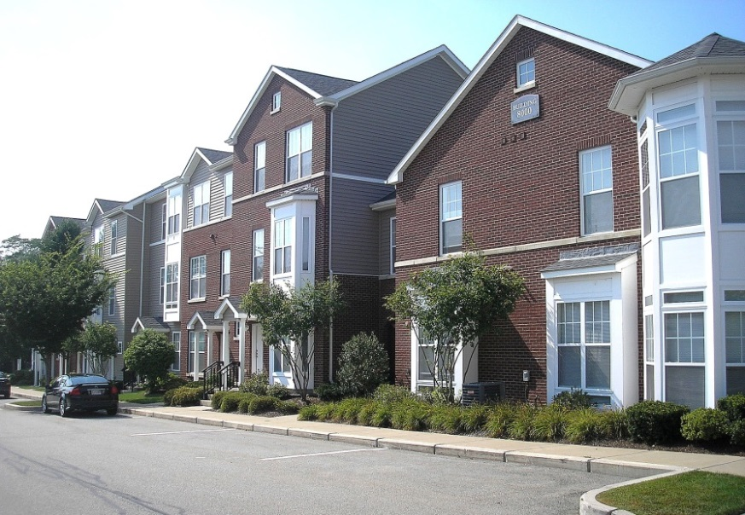
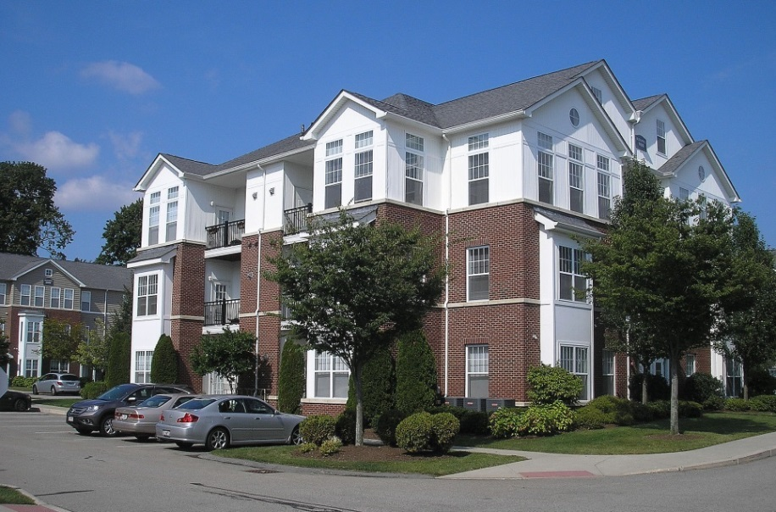
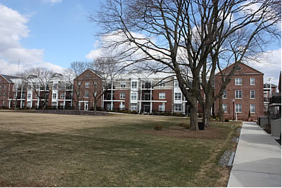
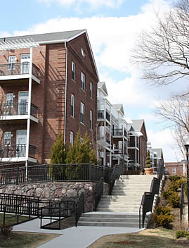
Metropolitan State Hospital (Waltham/Lexington)

Slide 63
Metropolitan State Hospital Reuse (Waltham/Lexington)
Features:
AvalonBay buildings with 387 apartment units
Primarily 1- BR and 2-BR; a few 3-BR
Multi- level town-houses
Market rates and 25% affordable housing
One building reserved for age 55+ housing
Retained one wall of an original hospital building
Un-developed McLaughlin Administration Building in Waltham
97% occupancy
23 acres developed surrounded by 300 acres of undeveloped land (92% open)
Key Points:
Higher-than-expected school enrollment and lower-than-expected assessment resulted in net loss to community
Limited covered parking (some townhouses have inside parking)
Isolated - 1 ½ miles from Lexington Center
Windows look out on to other apartments and walls

Slide 64
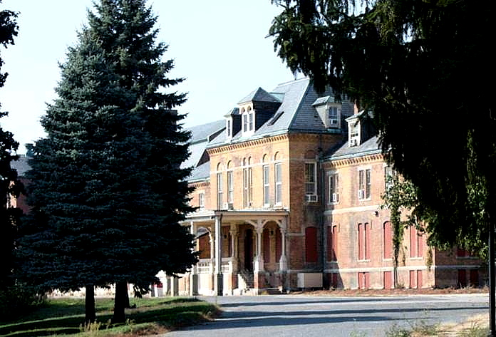
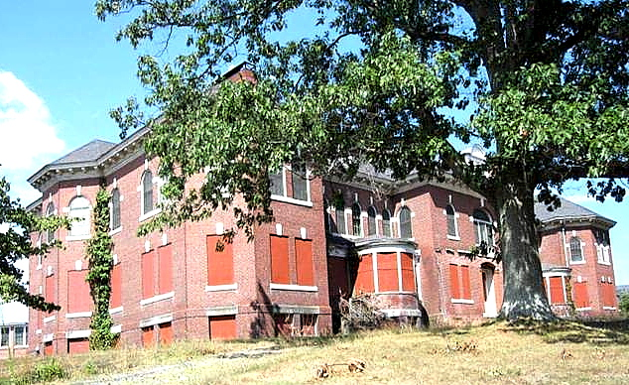
Westborough State Hospital
(Re-use of this hospital site is under discussion)

Slide 65
Westborough State Hospital Reuse
Features:
Subdivide 12 acres for 6 soccer fields and maintain as recreation area
Subdivide the remaining 83 acres into lots for commercial development
Potential for an estimated 1,000,000 sf of commercial development
Possible uses for commercial and retail development
Building redevelopment/removal responsibility of purchasers
Town residents and selectmen reluctant for residential development other than over 55 housing
Possibly renovate some original buildings if feasible
Key Points:
Town of Westborough approved purchase of 95 acres for $2.2 million
No detailed Master Plan developed yet
Main arguments for purchase:
prevent development of 500+ housing units
retain soccer fields
gain tax revenues from commercial development
avoid costs for construction of new school and added services

Slide 66
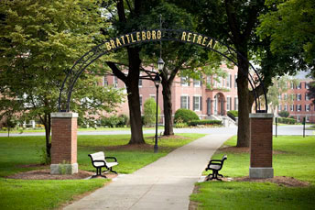
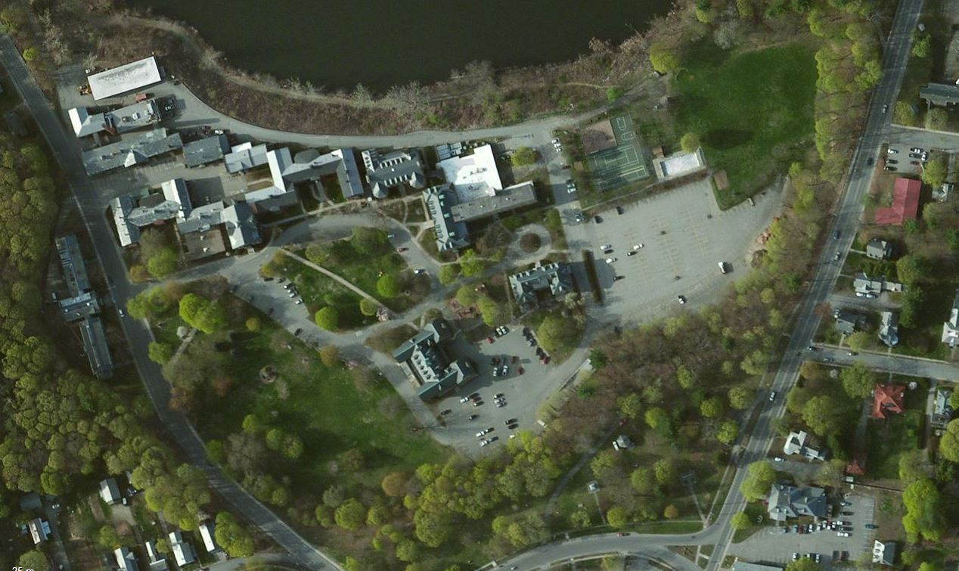
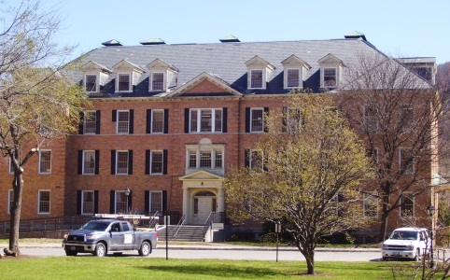
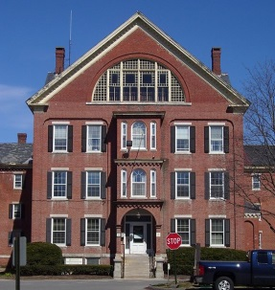
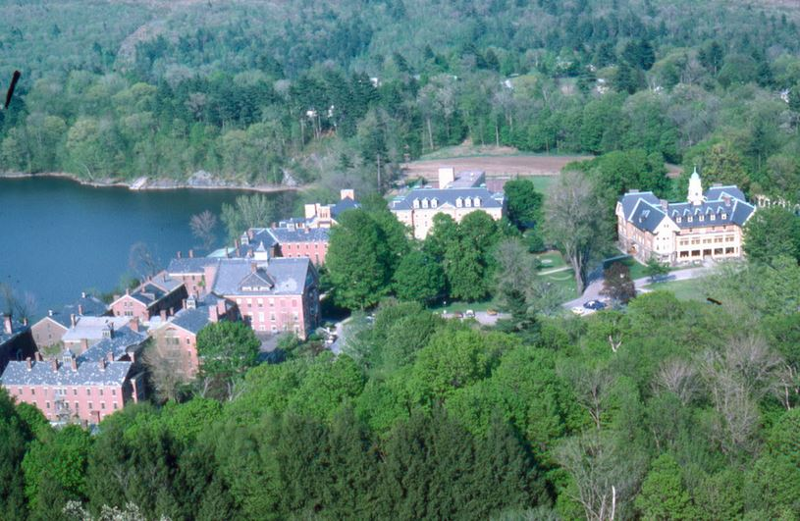
Brattleboro Retreat
Former Vermont State “Asylum or the Insane”
Started in 1834 with several buildings on National Register
Over 1,00 Acres and 58 buildings
Campus design with farm fields and bridal trails
Brattleboro Retreat one of first private mental health institutions in VT
Preservation of most core buildings
Significant conservation lands which good access to the public for passive recreation.

Slide 67
VISIONING
Medfield State Hospital
Public Workshop
Saturday, January 11th, 2014
SCENARIO-BUILDING BREAK-OUT SESSION
Groups of 10 – 15 Participants
Identify Preferred Future Land Uses and Building Types
Identify Preferred Locations on MSH Property (1:15 hrs)
Groups Report Back to All Workshop Participants (30 Min.)

Slide 68
VISIONING
Medfield State Hospital
Conservation and Recreation
What areas should be preserved the way they are?
What landmark buildings, open spaces or views should be preserved?
What are potential uses for open space areas?
Redevelopment
What areas or buildings should be redeveloped?
Are there any areas where there could be new development?
What are potential uses for existing or new buildings?
Where should different uses be located?
What should buildings look like?
Access and Connectivity
How would you get to the site by car or bike?
Where to put parking?
Where should there be sidewalks, trails and other pedestrian connections?
Community
What uses would support the life the community?
Where is the focus of community life?

Slide 69
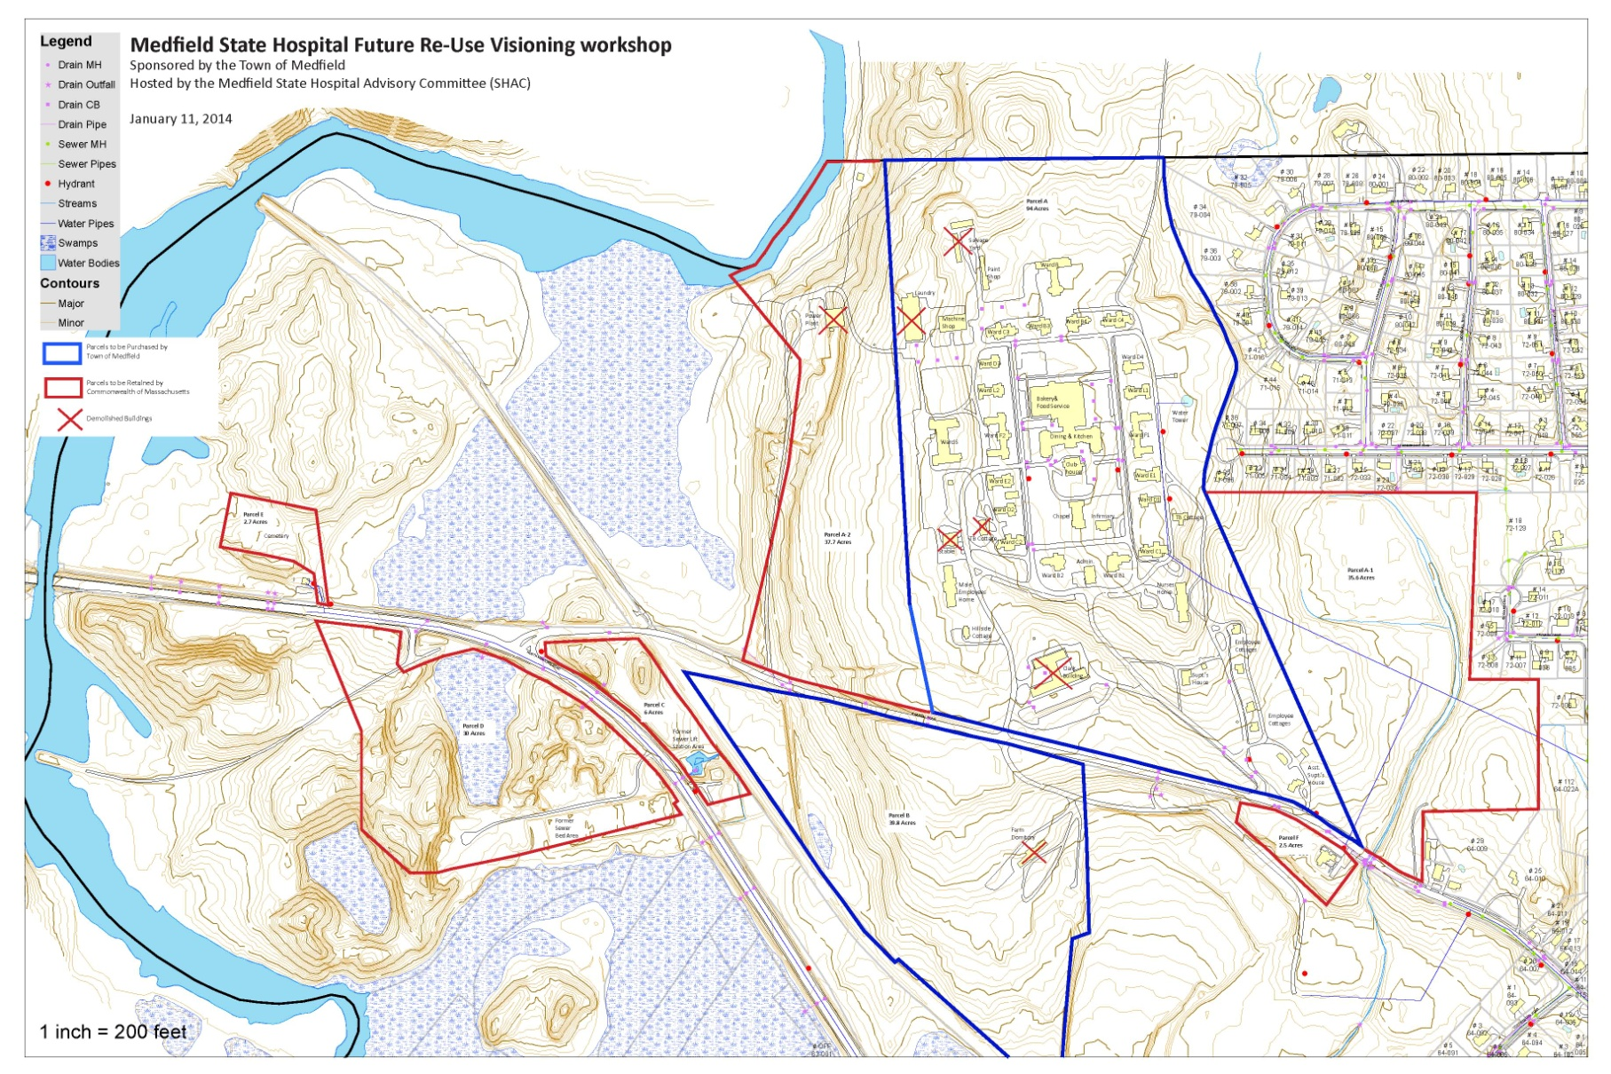
VISIONING
Medfield State Hospital

Slide 70
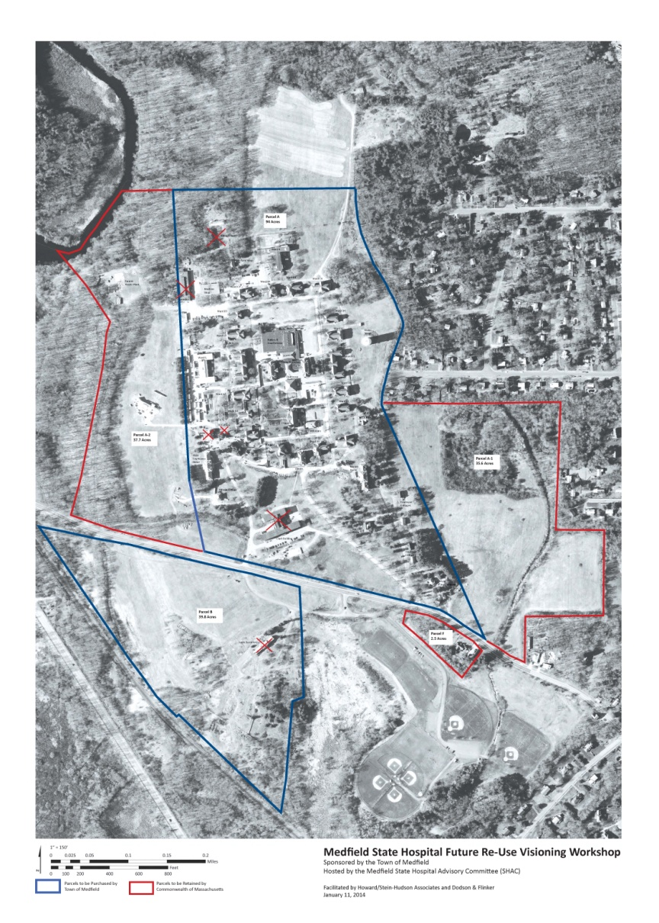
VISIONING
Medfield State Hospital
Conservation and Recreation
Redevelopment
Access and Connectivity
Community

Slide 71
VISIONING
Medfield State Hospital
Public Workshop
Saturday, January 11th, 2014
WORKSHOP WRAP UP
Next Steps
Adjournment
Thank You for Your Participation!

Slide 72
VISIONING
Medfield State Hospital
Public Workshop
Saturday, January 11th, 2014
STATE HOSPITAL ADVISORY COMMITTEE (SHAC)
Stephen Nolan, Chair
Kenneth Richard
James Rohnstock
Scott Colwell
Roberta Lynch
John Harney
Marc Verreault
Kerry McCormack
Robert Ingram
Gus Murby
Stephen Browne
Gil Rodgers
Rosamond Smythe
Alec Stevens

Slide 73
IMAGES OF MSH

Slide 74
VISIONING
Medfield State Hospital
Context

Slide 75
VISIONING
Medfield State Hospital
Base Map - Arial

Slide 76
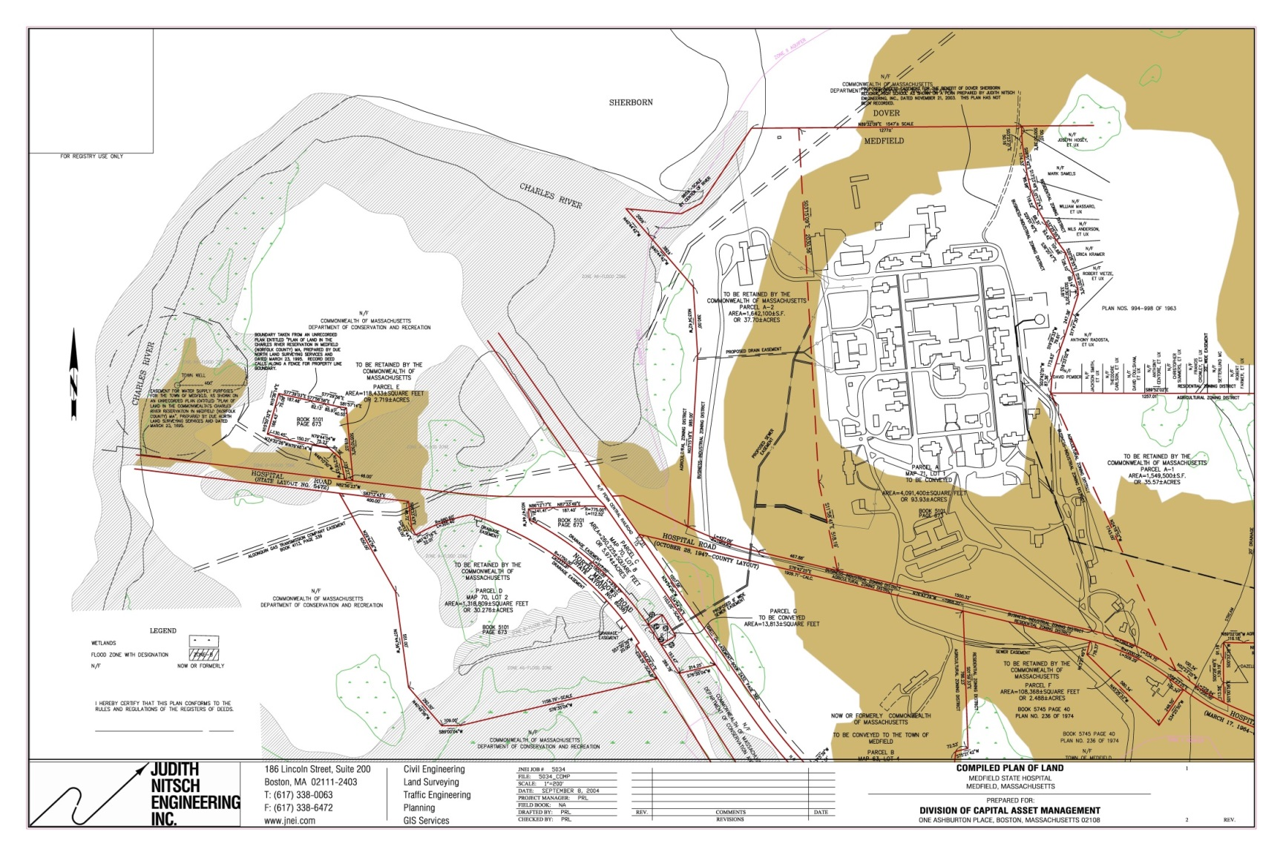
VISIONING
Medfield State Hospital
Prime Agricultural Soils and Wetlands

Slide 77
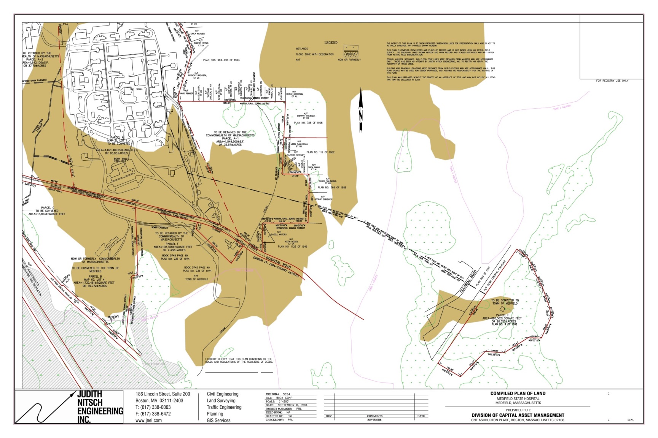
VISIONING
Medfield State Hospital
Prime Agricultural Soils and Wetlands

Slide 78
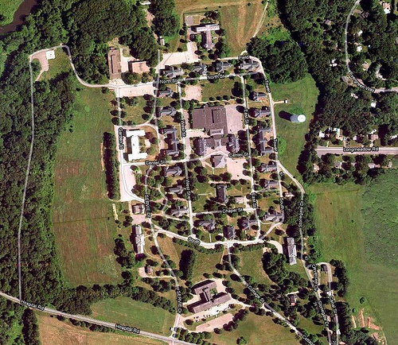

VISIONING
Medfield State Hospital
Quad and Core Campus

Slide 79


VISIONING
Medfield State Hospital
A Building and The Chapel

Slide 80


VISIONING
Medfield State Hospital
Quad and Core Campus

Slide 81


VISIONING
Medfield State Hospital
Quad and Core Campus

Slide 82


VISIONING
Medfield State Hospital
Quad and Core Campus

Slide 83



VISIONING
Medfield State Hospital
Quad and Core Campus

Slide 84


VISIONING
Medfield State Hospital
Core Campus

Slide 85

VISIONING
Medfield State Hospital
Quad and Core Campus

Slide 86

VISIONING
Medfield State Hospital
The Sledding Hill

