Slide 1
Medfield State Hospital Purchase Decision
Medfield Public Meeting
State Hospital Advisory Committee (SHAC)
Presentation and Recommendations
March 2014

Slide 2
Agenda
Decision
Property Description
Partnership Model
Vision and Uses for Property
Opportunities and Concerns
Cost Considerations
Legislative Timetable
SHAC Recommendations

Slide 3
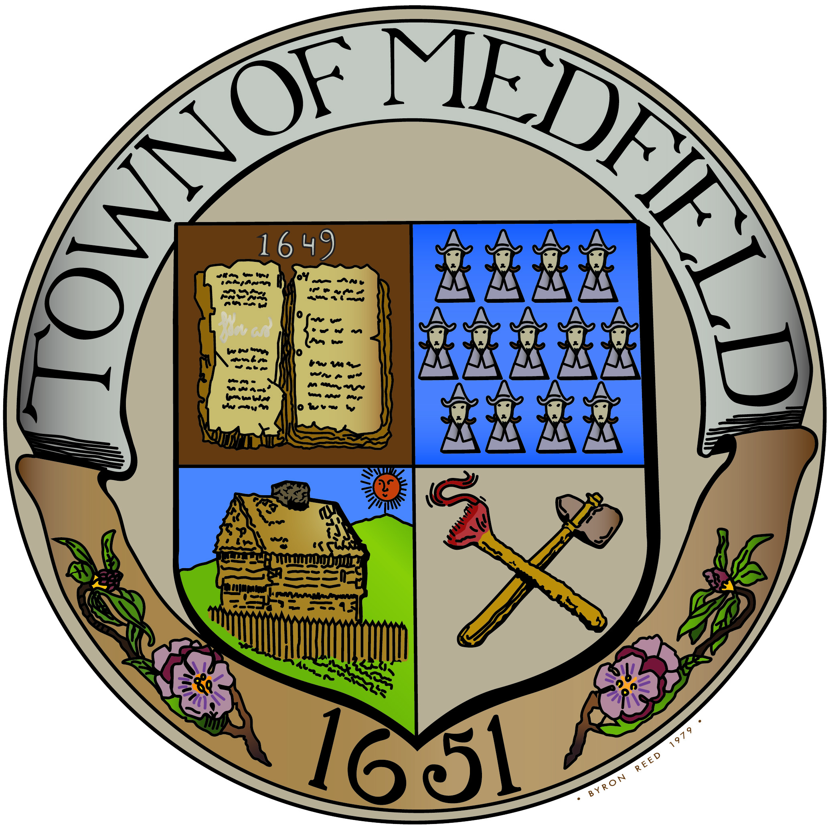

Decisions on March 10 and March 31
Medfield Controls Property
Town Election on 3/31/2014 (50% Majority)
YES
Town Meeting Vote on 3/10/2014
(2/3 ‘rds. to Pass)
YES
NO
NO
DCAMM Controls Property

Slide 4
Properties to be Transferred
Sale Parcels
A – Core Campus
≈ 94 acres
B – Sledding Hill
≈ 40 acres
Retained by State
A-1 – DCR
≈ 36 acres
A-2 – DCR
≈ 38 acres
C,D,E, F – Other State Agencies

Slide 5
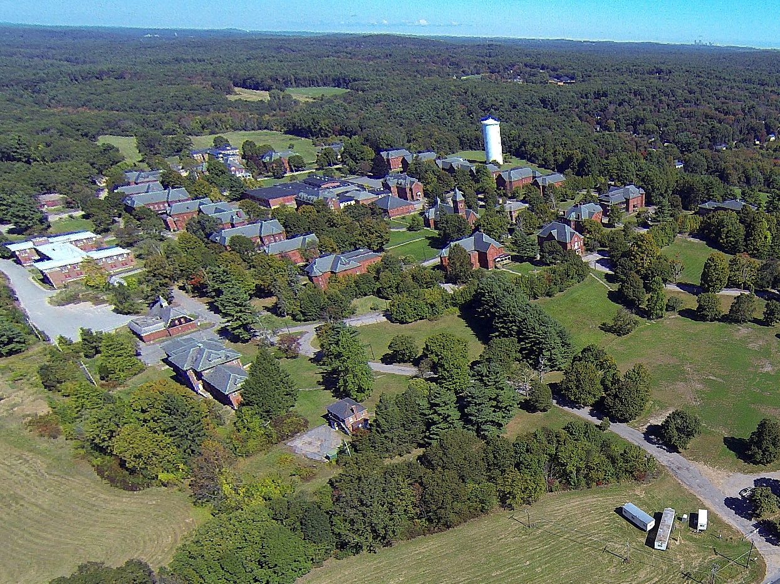
Core Campus (Parcel A)

Slide 6
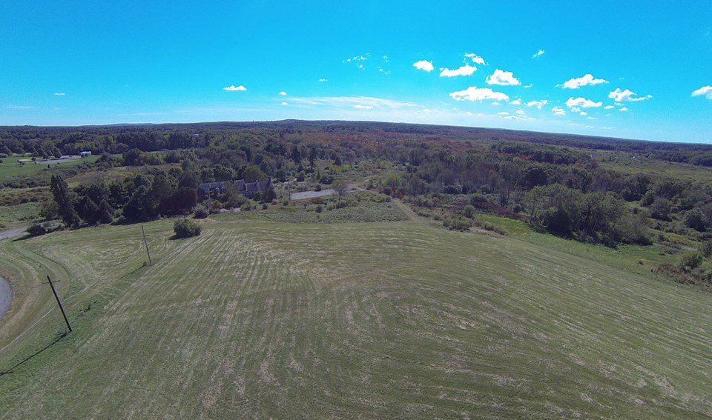
The Sledding Hill (Parcel B)

Slide 7
The Partnership Model
Purchase Parcels A and B for $3.1 million (includes interest) spread over 10 years ($310,000 per year)
Medfield entitled to at least 50% of net proceeds from sales
Incentives for additional 20% (70% total) based on meeting certain milestones within 2 years
No restrictions on use of Core Campus (Parcel A)
Construction on 12 acres on Parcel B limited to one town building (e.g. Park & Rec. Building)
Close before December 31, 2014

Slide 8
How Would Property be Re-Used?
Expressed Community Interests:
Mixed-use housing:
Senior housing, assisted living, CCRC
Single family homes and town houses
Affordable housing
Neighborhood retail and light commercial
Recreational building and passive recreation and agricultural uses
Performing arts and cultural center in Chapel
Open-space and trail connections
Sources: Medfield community survey of over 250 respondents (December 31, 2013), Municipal Workshop (December 12, 2013), and Public Visioning Workshop (January 11, 2014)

Slide 9
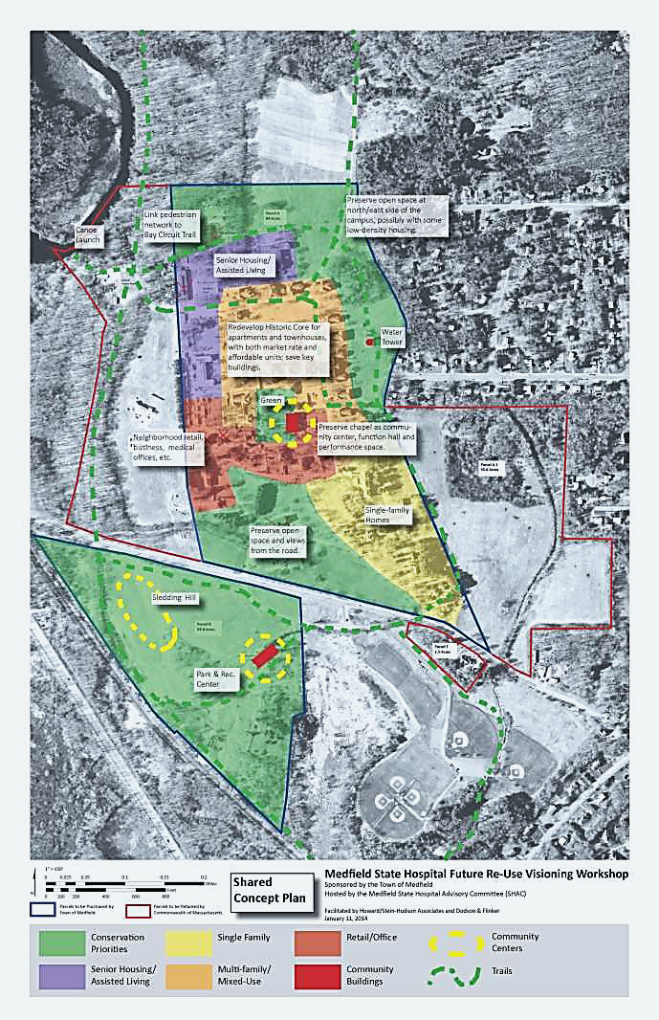
Vision for Future Re-use
Key
Conservation
Senior Housing/Assist-ed Living
Single Family
Mixed-Use Housing
Retail/Office
Community Buildings
Trails
Recreation
Visioning Workshop on January 11, 2014

Slide 10
Opportunities and Concerns
Vote in Favor of Purchase
Opportunities
Control over scale, size and type of development
Parcels A-1 and A-2 remain as open space
Ability to address specific wants and needs of Medfield
Development of revenue generating assets and community facilities
Concerns
Unanticipated remediation costs
Unforeseen carrying costs, including costs of building stabilization
Potential liabilities
Delays in reaching consensus on Master Plan

Slide 11
Opportunities and Concerns
Vote Against Purchase
Opportunities
No short term financial risk to Medfield
Concerns
Loss of control over development of property, including density and aesthetics
Possibility of a large 40B development (968 homeownership units would be needed to reach 10%; but only 170 rental units)
Long term costs of Town services relative to tax revenue (schools, public services, highways)
Limited input into legislation pertaining to Parcels A-1 and A-2

Slide 12
Last Comprehensive Assessment of Buildings Completed in 2003
10-year old study found many of the historical buildings in “fair condition at best”
Architectural significance of buildings, campus design, and location suggested re-use of the campus for “village-like” urban design with multiple-uses
Recommend preserve 19 historical buildings surrounding the central quad
Re-use Lee Building (chapel) as multi-function community center
“R” and “S” buildings, East and West Halls in relatively good shape and would serve as anchors on four sides of campus
Needed to mothball buildings to stabilize: provide heat, control moisture and leaks, stop decay, provide ventilation, and mitigate dry rot
Mothballing not done adequately – current conditions unknown but probably have deteriorated over 10 years
Source: “Medfield State Hospital Re Use Study,” Lozano, Baskin & Associates, February 24, 2003

Slide 13
What Would be Impact on Property Taxes from Purchase?
Annual purchase cost to Town is $310,000 per year for 10 years
Carrying costs approximately $150,000 per year until developed*
Assumes buildings demolished by developers
Assessed Value of Home | Increase in Property Taxes
$350,000 | $ 68 per year ($17 per quarter)
$550,000 | $104 per year ($26 per quarter)
$850,000 | $161 per year ($40 per quarter)
* Estimated by Town of Medfield Departments: Include security, fire protection, snow plowing, mowing, and maintenance. Does not include liability insurance. (February 28, 2014)

Slide 14
Medfield Controlled Development Scenario #1
Town-Controlled 120 Unit Senior Housing and 120 Unit 40B Housing
Increased education costs:
120 Units of family housing could result in 140 students
At average of $12,300/student cost to Medfield this could incur $1.7 million per year in expenses
Additional police, fire, ambulance, DPW and other Town services for 700 additional residents: $0.8 million per year
Increased tax revenues of $1.7 million per year (120 units @ $550,000 and 120 units @ $350,000)
Net cost to Town: $0.8 million per year
Net proceeds to Town from sale of land to off-set purchase cost
*Estimate from Medfield Superintendent of Schools: Average cost per pupil of $12,300. Costs for other public services provide by Town Administrator ≈$1200/resident. (February 28, 2014)

Slide 15
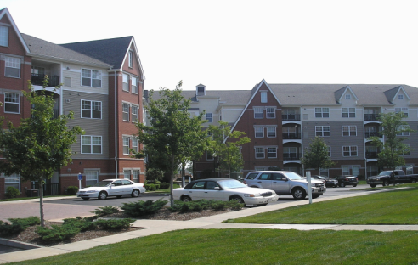
Family Housing Development Scenario #2
480 Unit Family Development
Increased education costs:
480 units of family housing resulting in 576 students
At average of $12,300/student cost to Medfield this could incur $ 7.1 million per year in expenses
Additional police, fire, ambulance, DPW and other Town services for 1,500 additional residents: $1.8 million per year
Increased tax revenues of $3.7 million per year (480 units @ $475,000)
Net cost to Town: $5.2 million per year
Net proceeds to Town from sale of land to off-set purchase cost

Slide 16
DCAMM Controlled Housing Scenario #3
State-Controlled 968-Unit 40B Housing
Increased education costs:
968 Units of family housing could result in 1,200 students
At average of $12,300/student cost to Medfield this could incur $14.8 million per year in expenses
Additional police, fire, ambulance, DPW and other Town services for 3,100 additional residents: $3.7 million per year
Increased tax revenues of $7.4 million per year (968 units @ $475,000)
Net cost to Town: $11.1 million per year
No proceeds to Town from sale of land

Slide 17
What Would be Potential Costs to Medfield for Building Demolition and Abatement?
DCAMM estimate for prevailing-wage remediation and demolition costs: $11-$14 per square foot*
Total cost range of $6.6 to $8.4 million based on building area of approximately 600,000 square feet
Remediation of hazardous disposal sites completed by DCAMM per settlement agreement at no cost to Town
Developer cost of remediation of buildings and campus less than DCAMM estimate since not done at prevailing wages
*DCAMM, Cost factors based on other state hospitals including abatement, demolition, and transportation; January 9, 2014

Slide 18
Potential Sales Strategy for Medfield
Scenario #1 --Town-Controlled 120 Unit Senior Housing and 120 Unit 40B Housing
Sales:
34 units of single-family senior housing at $160,000 per lot* = $5.4 million
86 units of senior condominiums at $27,000 per unit* = $2.3 million
120 units of family apartments at $27,000 per unit* = $3.2 million
Developer demolition costs estimated = $8.4 million
Aggregate sales price net of demolition costs: $2.6 million
Assume 50% - 50% sharing and no deduction of sales costs
Medfield Share: $1.3 million
*Estimates from Medfield Board of Assessors. Informal estimates from senior housing and affordable housing developers range from $20,000 to $60,000 per unit for apartments and condos.

Slide 19
Legislative Timetable is Very Tight

Slide 20
SHAC Recommendations
SHAC Recommends Purchasing Property by 10-3 Vote, subject to considerations set forth below
Considerations
Town should rapidly appoint a committee to prepare Master Plan for re-use
Town should expeditiously re-zone the property and sell portions of property for re-development
Voters should be aware of worst-case scenarios for long-term carrying and demolition costs if the property is not re-developed

